Slide 1
Environment Overview
^{Project:}
KC-APOLLO 2020-09-01 14:50 -05:00
Project ID:
1125686
^{Prepared for:}
Reaha Dahlke, RDahlke@kcata.org
^{Prepared by:}
^{Adam Moss, adam.moss@dell.com}
^{Created:}
^{9/2/2020}

Slide 2
About this Report
This document is an assessment of the server and storage workloads based on servers, server disk activity, and storage capacity as observed during the data collection. The data depicted in this report may be used to make recommendations on future configurations and solutions. This report may be used to identify times of peak IO activity, and marks the critical 95th IOPS thresholds, a key metric used as a baseline for storage sizing. This report includes details on servers, CPU and memory usage, as well as free and used storage capacities. If you have any questions regarding the information presented in this report, please contact your Dell team for immediate assistance.

Slide 3
Performance Envelope
^{CPU}
^{Capacity}
^{Peak CPU}
^{Net CPU}
^{Cores}
^{Used GB}
^{Free GB}
^{Total GB}
^{25.10 GHz}
^{413.20 GHz}
²¹⁴
^{21.44 TB}
^{10.10 TB}
^{31.54 TB}
^{Memory}
Peak Aggregate Network Throughput
^{Peak Memory Usage}
^{Total Memory}
^{283.48 megabits/s}
^{220.68 GB}
^{537.41 GB}
^{IOPS at 95%}
^{Average Daily Write}
^{2,409}
^{643.42 GB}

Slide 4
Inventory Summary

Slide 5
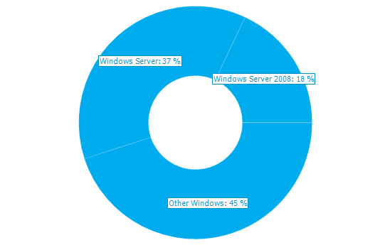
Inventory Summary
SERVER ROLES
TOP OPERATING SYSTEMS
Total Servers: 38
Ratio: 0.0 VMs per Hypervisor
TOP SERVER MANUFACTURERS
Total Manufacturers: 1

Slide 6
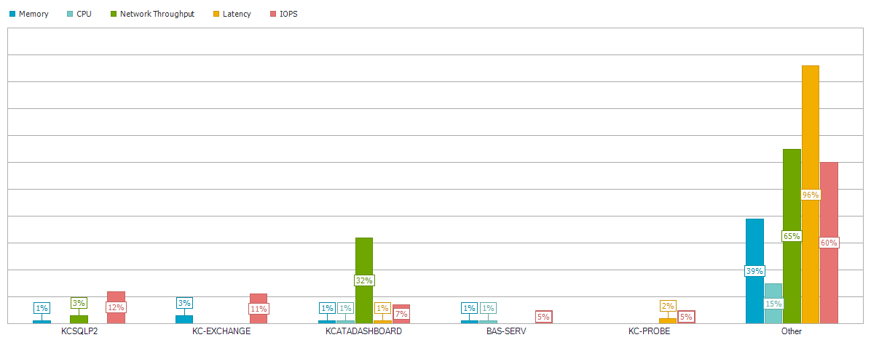
Top 5 Servers by IOPS

Slide 7
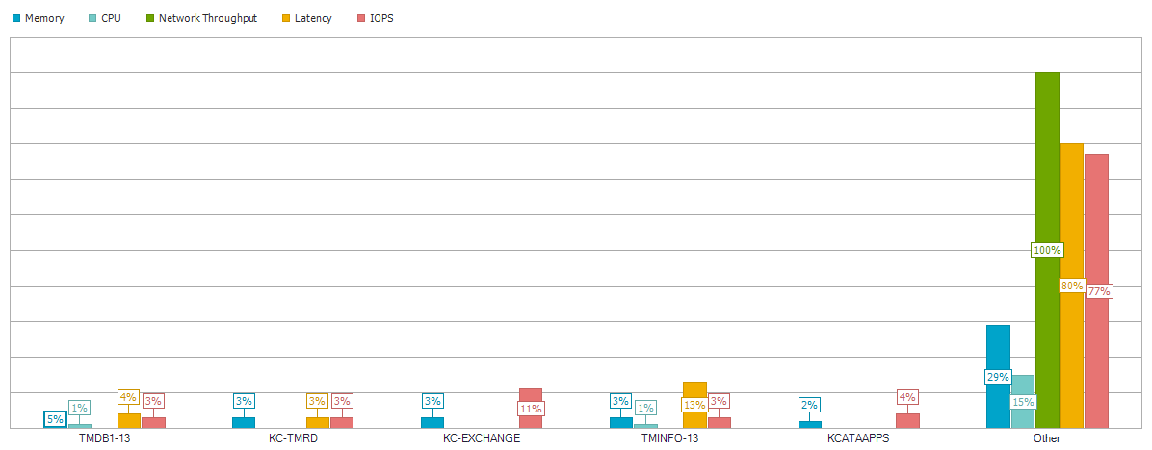
Top 5 Servers by Memory

Slide 8
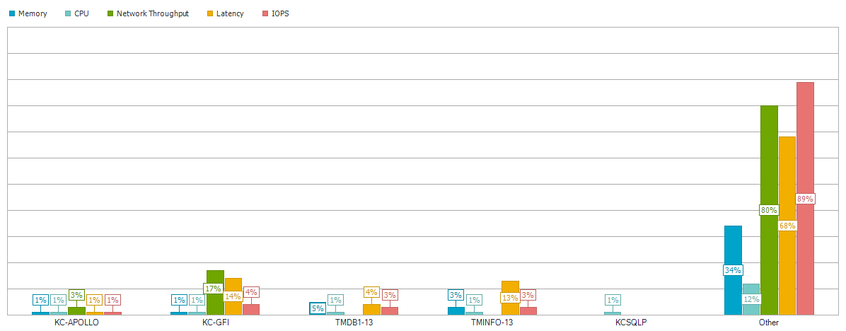
Top 5 Servers by CPU

Slide 9
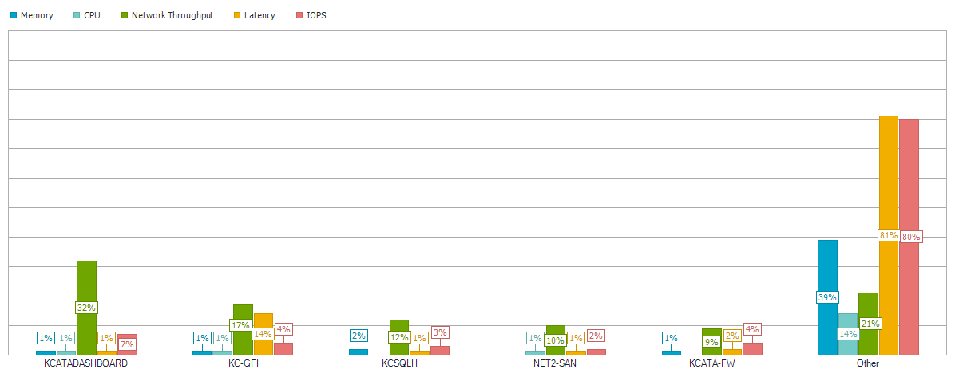
Top 5 Servers by Network Throughput

Slide 10
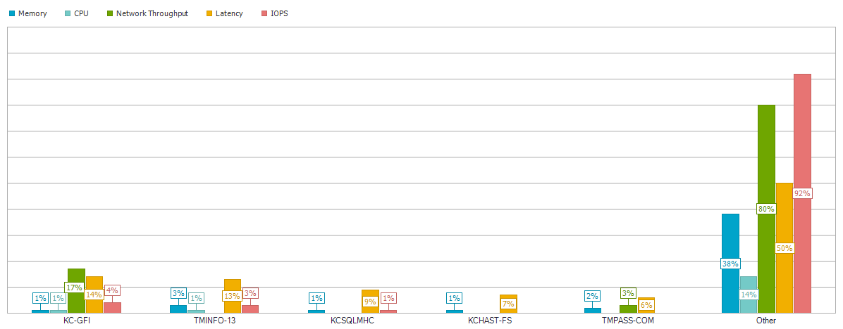
Top 5 Servers by Latency

Slide 11
CPU Performance

Slide 12
CPU Performance

Slide 13
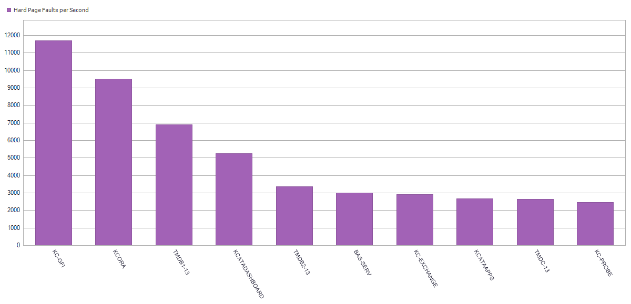
CPU Performance

Slide 14
CPU Performance
Total Cores | 214
Total CPUs | 71
Net Clockspeed | 413 GHz
Peak CPU | 25 GHz
Average CPU | 13 GHz
Peak Memory Usage | 220.68 GB of 537.41 GB Total Memory

Slide 15
Storage Capacity

Slide 16
Storage Capacity
Total Local Capacity | 31.05 TB
Used Local Capacity | 20.97 TB
Free Local Capacity | 10.08 TB
Total Shared Capacity | 500.00 GB
Used Shared Capacity | 482.00 GB
Free Shared Capacity | 18.00 GB

Slide 17
IO Performance

Slide 18
IO Performance

Slide 19
IO Performance

Slide 20
IO Performance

Slide 21
IO Performance
Peak IOPS | 10401
IOPS at 95% | 2409
Peak Disk Throughput | 319 MB/s
Peak Aggregate Network Throughput | 35 MB/s
Average Daily Write | 643.42 GB
Read/Write Ratio | 90% / 10%
Average IO Read Size | 60.19 KB
Average IO Write Size | 73.20 KB

Slide 22
KCSQLH

Slide 23
KCSQLH
Operating System | Microsoft Windows Server 2008 R2 Standard Service Pack 1
Time Recorded | 0 Hour(s), 0 Minute(s), 9/1/2020 - na
IOPS | 511 at 95%
Peak Disk Throughput | 224.60 MB/s
Read/Write Ratio | 92% / 8%
Total Local Capacity | 838.00 GB
Free Local Capacity | 92.00 GB (11%)
Used Local Capacity | 746.00 GB (89%)

Slide 24
KCSQLH
Average IO Size | Read: 150.15 KB / Write: 144.82 KB
Average Latency | Read: 8.65 ms / Write: 0.69 ms
Average Queue Depth | 5
Peak/Min CPU | 11% / 0%
Peak/Min Memory | 7.51 GB / 9.55 GB
Peak/Min Memory In Use | 8.48 GB / 6.44 GB
CPU Sockets | 2
CPU Cores | 8
CPU Description | Intel(R) Xeon(R) CPU X5667 @ 3.07GHz

Slide 25
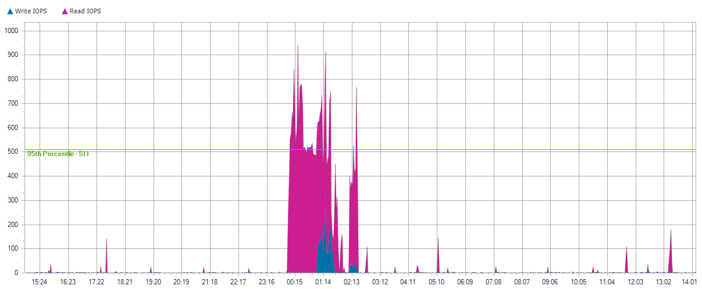
KCSQLH

Slide 26
KCSQLH

Slide 27
KCSQLH

Slide 28
Local Disks for KCSQLH

Slide 29
0 C:
Server Name | KCSQLH
Server Operating System | Microsoft Windows Server 2008 R2 Standard Service Pack 1
Total Local Capacity | 838.00 GB
Free Local Capacity | 92.00 GB (11%)
Used Local Capacity | 746.00 GB (89%)
Peak Throughput | 224.60 MB/s
Average Latency | 8.65 ms Reads and 0.69 ms Writes
IOPS | 511 at 95%
Read/Write Ratio | 92% / 8%
Average IO Size | Read: 150.15 KB / Write: 144.82 KB

Slide 30
0 C:

Slide 31
0 C:

Slide 32
0 C:

Slide 33
KCORA

Slide 34
KCORA
Operating System | Microsoft(R) Windows(R) Server 2003 Standard Edition Service Pack 2
Time Recorded | 0 Hour(s), 0 Minute(s), 9/1/2020 - na
IOPS | 473 at 95%
Peak Disk Throughput | 143.60 MB/s
Read/Write Ratio | 90% / 10%
Total Local Capacity | 132.00 GB
Free Local Capacity | 22.00 GB (17%)
Used Local Capacity | 110.00 GB (83%)

Slide 35
KCORA
Average IO Size | Read: 236.46 KB / Write: 12.97 KB
Average Latency | Read: 0.02 ms / Write: 1.58 ms
Average Queue Depth | 1
Peak/Min CPU | 10% / 0%
Peak/Min Memory | 1.96 GB / 2.06 GB
Peak/Min Memory In Use | 1.54 GB / 1.44 GB
CPU Sockets | 4
CPU Cores | 4
CPU Description | Intel(R) Xeon(TM) CPU 3.40GHz

Slide 36
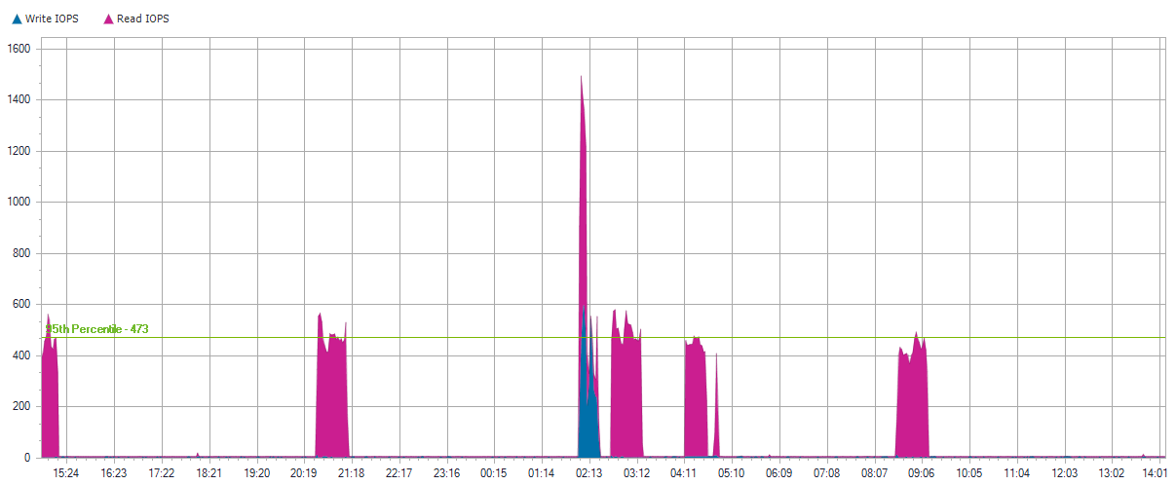
KCORA

Slide 37
KCORA

Slide 38
KCORA

Slide 39
Local Disks for KCORA

Slide 40
0 C:
Server Name | KCORA
Server Operating System | Microsoft(R) Windows(R) Server 2003 Standard Edition Service Pack 2
Total Local Capacity | 34.00 GB
Free Local Capacity | 3.00 GB (9%)
Used Local Capacity | 31.00 GB (91%)
Peak Throughput | 37.00 MB/s
Average Latency | 1.66 ms Reads and 1.63 ms Writes
IOPS | 4 at 95%
Read/Write Ratio | 64% / 36%
Average IO Size | Read: 20.93 KB / Write: 17.32 KB

Slide 41
0 C:

Slide 42
0 C:

Slide 43
0 C:

Slide 44
1 D:
Server Name | KCORA
Server Operating System | Microsoft(R) Windows(R) Server 2003 Standard Edition Service Pack 2
Total Local Capacity | 68.00 GB
Free Local Capacity | 8.00 GB (12%)
Used Local Capacity | 60.00 GB (88%)
Peak Throughput | 143.40 MB/s
Average Latency | 0.35 ms Reads and 2.28 ms Writes
IOPS | 466 at 95%
Read/Write Ratio | 93% / 7%
Average IO Size | Read: 236.73 KB / Write: 11.11 KB

Slide 45
1 D:

Slide 46
1 D:

Slide 47
1 D:

Slide 48
2 N:
Server Name | KCORA
Server Operating System | Microsoft(R) Windows(R) Server 2003 Standard Edition Service Pack 2
Total Local Capacity | 30.00 GB
Free Local Capacity | 11.00 GB (37%)
Used Local Capacity | 19.00 GB (63%)
Peak Throughput | 0.00 MB/s
Average Latency | 0.00 ms Reads and 0.00 ms Writes
IOPS | 0 at 95%
Read/Write Ratio | 0% / 100%
Average IO Size | Read: 0 KB / Write: 0 KB

Slide 49
2 N:

Slide 50
2 N:

Slide 51
2 N:

Slide 52
TMINFO-13

Slide 53
TMINFO-13
Operating System | Microsoft Windows Server 2008 R2 Standard Service Pack 1
Time Recorded | 0 Hour(s), 0 Minute(s), 9/1/2020 - na
IOPS | 259 at 95%
Peak Disk Throughput | 54.30 MB/s
Read/Write Ratio | 73% / 27%
Total Local Capacity | 1.44 TB
Free Local Capacity | 537.00 GB (36%)
Used Local Capacity | 942.00 GB (64%)

Slide 54
TMINFO-13
Average IO Size | Read: 161.32 KB / Write: 21.91 KB
Average Latency | Read: 36.67 ms / Write: 73.32 ms
Average Queue Depth | 33
Peak/Min CPU | 30% / 0%
Peak/Min Memory | 2.36 GB / 3.08 GB
Peak/Min Memory In Use | 13.63 GB / 12.91 GB
CPU Sockets | 2
CPU Cores | 8
CPU Description | Intel(R) Xeon(R) CPU E5620 @ 2.40GHz

Slide 55
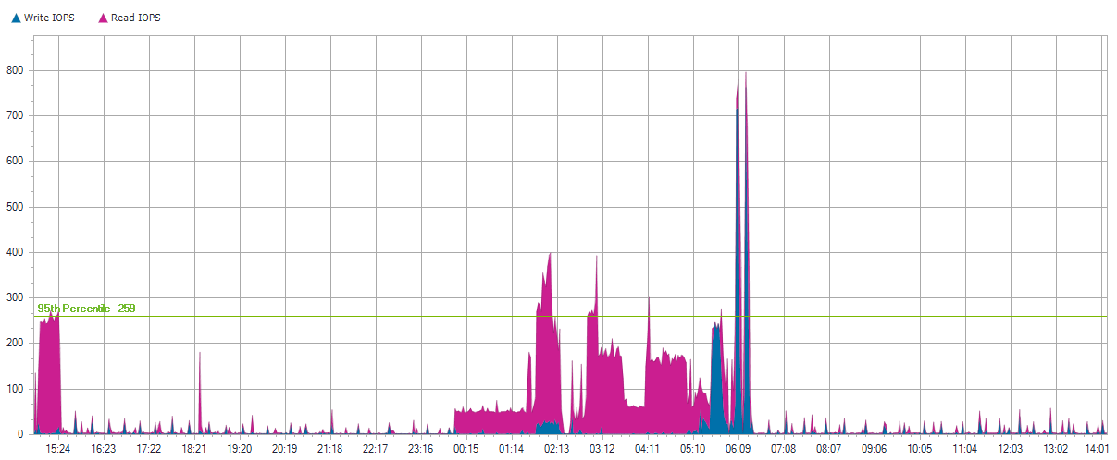
TMINFO-13

Slide 56
TMINFO-13

Slide 57
TMINFO-13

Slide 58
Local Disks for TMINFO-13

Slide 59
0 C:
Server Name | TMINFO-13
Server Operating System | Microsoft Windows Server 2008 R2 Standard Service Pack 1
Total Local Capacity | 279.00 GB
Free Local Capacity | 179.00 GB (64%)
Used Local Capacity | 100.00 GB (36%)
Peak Throughput | 11.70 MB/s
Average Latency | 2.82 ms Reads and 14.67 ms Writes
IOPS | 29 at 95%
Read/Write Ratio | 82% / 18%
Average IO Size | Read: 22.71 KB / Write: 40.86 KB

Slide 60
0 C:

Slide 61
0 C:

Slide 62
0 C:

Slide 63
1 D:
Server Name | TMINFO-13
Server Operating System | Microsoft Windows Server 2008 R2 Standard Service Pack 1
Total Local Capacity | 1.17 TB
Free Local Capacity | 358.00 GB (30%)
Used Local Capacity | 842.00 GB (70%)
Peak Throughput | 52.60 MB/s
Average Latency | 42.55 ms Reads and 158.00 ms Writes
IOPS | 224 at 95%
Read/Write Ratio | 74% / 26%
Average IO Size | Read: 196.51 KB / Write: 10.66 KB

Slide 64
1 D:

Slide 65
1 D:

Slide 66
1 D:

Slide 67
KC-GFI

Slide 68
KC-GFI
Operating System | Microsoft Windows Server 2008 Standard Service Pack 2
Time Recorded | 0 Hour(s), 0 Minute(s), 9/1/2020 - na
IOPS | 256 at 95%
Peak Disk Throughput | 100.10 MB/s
Read/Write Ratio | 91% / 9%
Total Local Capacity | 332.00 GB
Free Local Capacity | 152.00 GB (46%)
Used Local Capacity | 180.00 GB (54%)

Slide 69
KC-GFI
Average IO Size | Read: 142.09 KB / Write: 114.37 KB
Average Latency | Read: 7.13 ms / Write: 114.90 ms
Average Queue Depth | 5
Peak/Min CPU | 29% / 4%
Peak/Min Memory | 1.76 GB / 2.73 GB
Peak/Min Memory In Use | 6.23 GB / 5.27 GB
CPU Sockets | 2
CPU Cores | 8
CPU Description | Intel(R) Xeon(R) CPU E5410 @ 2.33GHz

Slide 70
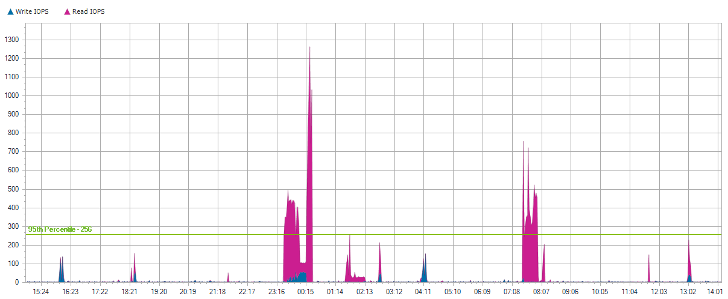
KC-GFI

Slide 71
KC-GFI

Slide 72
KC-GFI

Slide 73
Local Disks for KC-GFI

Slide 74
0 C:
Server Name | KC-GFI
Server Operating System | Microsoft Windows Server 2008 Standard Service Pack 2
Total Local Capacity | 137.00 GB
Free Local Capacity | 37.00 GB (27%)
Used Local Capacity | 100.00 GB (73%)
Peak Throughput | 78.80 MB/s
Average Latency | 23.23 ms Reads and 113.98 ms Writes
IOPS | 122 at 95%
Read/Write Ratio | 88% / 12%
Average IO Size | Read: 42.11 KB / Write: 115.68 KB

Slide 75
0 C:

Slide 76
0 C:

Slide 77
0 C:

Slide 78
1 D:
Server Name | KC-GFI
Server Operating System | Microsoft Windows Server 2008 Standard Service Pack 2
Total Local Capacity | 195.00 GB
Free Local Capacity | 115.00 GB (59%)
Used Local Capacity | 80.00 GB (41%)
Peak Throughput | 50.00 MB/s
Average Latency | 5.68 ms Reads and 19.59 ms Writes
IOPS | 0 at 95%
Read/Write Ratio | 99% / 1%
Average IO Size | Read: 119.76 KB / Write: 14.09 KB

Slide 79
1 D:

Slide 80
1 D:

Slide 81
1 D:

Slide 82
TMDC-13

Slide 83
TMDC-13
Operating System | Microsoft Windows Server 2008 R2 Standard Service Pack 1
Time Recorded | 0 Hour(s), 0 Minute(s), 9/1/2020 - na
IOPS | 245 at 95%
Peak Disk Throughput | 21.00 MB/s
Read/Write Ratio | 84% / 16%
Total Local Capacity | 279.00 GB
Free Local Capacity | 96.00 GB (34%)
Used Local Capacity | 183.00 GB (66%)

Slide 84
TMDC-13
Average IO Size | Read: 17.51 KB / Write: 38.76 KB
Average Latency | Read: 2.30 ms / Write: 14.29 ms
Average Queue Depth | 2
Peak/Min CPU | 18% / 1%
Peak/Min Memory | 565.72 MB / 1.35 GB
Peak/Min Memory In Use | 7.44 GB / 6.64 GB
CPU Sockets | 1
CPU Cores | 4
CPU Description | Intel(R) Xeon(R) CPU E5620 @ 2.40GHz

Slide 85
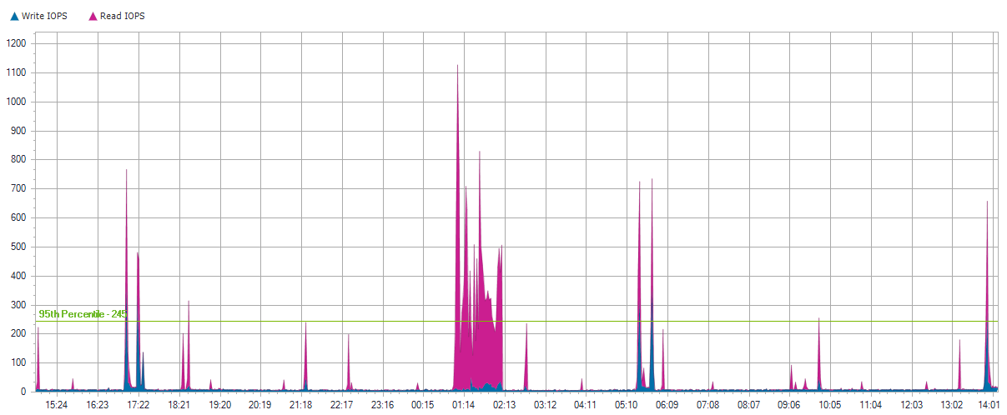
TMDC-13

Slide 86
TMDC-13

Slide 87
TMDC-13

Slide 88
Local Disks for TMDC-13

Slide 89
0 C:
Server Name | TMDC-13
Server Operating System | Microsoft Windows Server 2008 R2 Standard Service Pack 1
Total Local Capacity | 279.00 GB
Free Local Capacity | 96.00 GB (34%)
Used Local Capacity | 183.00 GB (66%)
Peak Throughput | 21.00 MB/s
Average Latency | 2.30 ms Reads and 14.29 ms Writes
IOPS | 245 at 95%
Read/Write Ratio | 84% / 16%
Average IO Size | Read: 17.51 KB / Write: 38.76 KB

Slide 90
0 C:

Slide 91
0 C:

Slide 92
0 C:

Slide 93
KC-APOLLO

Slide 94
KC-APOLLO
Operating System | Microsoft Windows Server 2012 R2 Standard
Time Recorded | 0 Hour(s), 0 Minute(s), 9/1/2020 - na
IOPS | 199 at 95%
Peak Disk Throughput | 11.40 MB/s
Read/Write Ratio | 21% / 79%
Total Local Capacity | 12.74 TB
Free Local Capacity | 2.72 TB (21%)
Used Local Capacity | 10.01 TB (79%)

Slide 95
KC-APOLLO
Average IO Size | Read: 22.14 KB / Write: 7.00 KB
Average Latency | Read: 7.20 ms / Write: 0.58 ms
Average Queue Depth | 0
Peak/Min CPU | 83% / 0%
Peak/Min Memory | 9.20 GB / 13.50 GB
Peak/Min Memory In Use | 6.68 GB / 2.37 GB
CPU Sockets | 1
CPU Cores | 6
CPU Description | Intel(R) Xeon(R) CPU E5-2620 v3 @ 2.40GHz

Slide 96
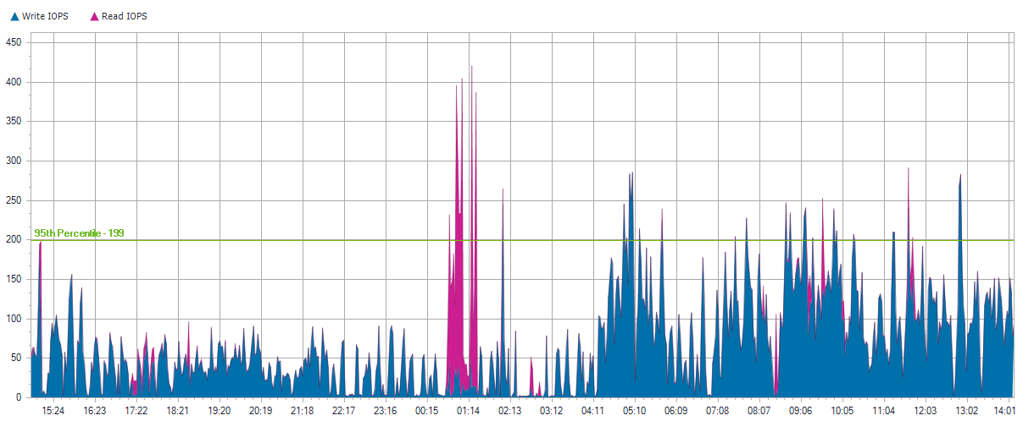
KC-APOLLO

Slide 97
KC-APOLLO

Slide 98
KC-APOLLO

Slide 99
Local Disks for KC-APOLLO

Slide 100
0 C:
Server Name | KC-APOLLO
Server Operating System | Microsoft Windows Server 2012 R2 Standard
Total Local Capacity | 12.74 TB
Free Local Capacity | 2.72 TB (21%)
Used Local Capacity | 10.01 TB (79%)
Peak Throughput | 11.40 MB/s
Average Latency | 7.20 ms Reads and 0.58 ms Writes
IOPS | 199 at 95%
Read/Write Ratio | 21% / 79%
Average IO Size | Read: 22.14 KB / Write: 7.00 KB

Slide 101
0 C:

Slide 102
0 C:

Slide 103
0 C:

Slide 104
KCATA-FS

Slide 105
KCATA-FS
Operating System | Microsoft Windows Server 2008 R2 Standard Service Pack 1
Time Recorded | 0 Hour(s), 0 Minute(s), 9/1/2020 - na
IOPS | 199 at 95%
Peak Disk Throughput | 10.40 MB/s
Read/Write Ratio | 94% / 6%
Total Local Capacity | 1.82 TB
Free Local Capacity | 101.00 GB (5%)
Used Local Capacity | 1.73 TB (95%)

Slide 106
KCATA-FS
Average IO Size | Read: 6.56 KB / Write: 48.75 KB
Average Latency | Read: 2.52 ms / Write: 15.88 ms
Average Queue Depth | 1
Peak/Min CPU | 15% / 0%
Peak/Min Memory | 1.91 GB / 4.74 GB
Peak/Min Memory In Use | 6.09 GB / 3.26 GB
CPU Sockets | 2
CPU Cores | 8
CPU Description | Intel(R) Xeon(R) CPU E5405 @ 2.00GHz

Slide 107
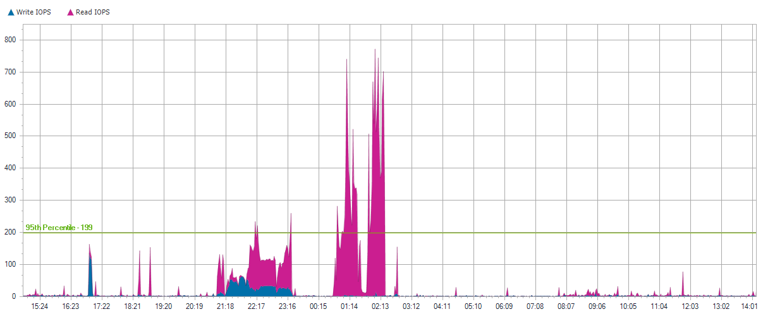
KCATA-FS

Slide 108
KCATA-FS

Slide 109
KCATA-FS

Slide 110
Local Disks for KCATA-FS

Slide 111
0 C:
Server Name | KCATA-FS
Server Operating System | Microsoft Windows Server 2008 R2 Standard Service Pack 1
Total Local Capacity | 137.00 GB
Free Local Capacity | 25.00 GB (18%)
Used Local Capacity | 112.00 GB (82%)
Peak Throughput | 8.20 MB/s
Average Latency | 5.25 ms Reads and 20.48 ms Writes
IOPS | 11 at 95%
Read/Write Ratio | 70% / 30%
Average IO Size | Read: 17.30 KB / Write: 27.36 KB

Slide 112
0 C:

Slide 113
0 C:

Slide 114
0 C:

Slide 115
1 H: H:
Server Name | KCATA-FS
Server Operating System | Microsoft Windows Server 2008 R2 Standard Service Pack 1
Total Local Capacity | 547.00 GB
Free Local Capacity | 24.00 GB (4%)
Used Local Capacity | 523.00 GB (96%)
Peak Throughput | 3.80 MB/s
Average Latency | 3.31 ms Reads and 14.64 ms Writes
IOPS | 26 at 95%
Read/Write Ratio | 94% / 6%
Average IO Size | Read: 8.46 KB / Write: 43.49 KB

Slide 116
1 H: H:

Slide 117
1 H: H:

Slide 118
1 H: H:

Slide 119
2 H: H:
Server Name | KCATA-FS
Server Operating System | Microsoft Windows Server 2008 R2 Standard Service Pack 1
Total Local Capacity | 1.16 TB
Free Local Capacity | 52.00 GB (4%)
Used Local Capacity | 1.11 TB (96%)
Peak Throughput | 7.80 MB/s
Average Latency | 2.12 ms Reads and 10.39 ms Writes
IOPS | 168 at 95%
Read/Write Ratio | 97% / 3%
Average IO Size | Read: 3.98 KB / Write: 19.69 KB

Slide 120
2 H: H:

Slide 121
2 H: H:

Slide 122
2 H: H:

Slide 123
NET2-SAN

Slide 124
NET2-SAN
Operating System | Microsoft Windows Storage Server 2008 Standard Service Pack 1
Time Recorded | 0 Hour(s), 0 Minute(s), 9/1/2020 - na
IOPS | 171 at 95%
Peak Disk Throughput | 8.70 MB/s
Read/Write Ratio | 94% / 6%
Total Local Capacity | 1.20 TB
Free Local Capacity | 12.00 GB (1%)
Used Local Capacity | 1.19 TB (99%)

Slide 125
NET2-SAN
Average IO Size | Read: 5.05 KB / Write: 16.08 KB
Average Latency | Read: 1.20 ms / Write: 11.14 ms
Average Queue Depth | 0
Peak/Min CPU | 27% / 0%
Peak/Min Memory | 1.40 GB / 2.60 GB
Peak/Min Memory In Use | 2.59 GB / 1.39 GB
CPU Sockets | 1
CPU Cores | 4
CPU Description | Intel(R) Xeon(R) CPU L5506 @ 2.13GHz

Slide 126
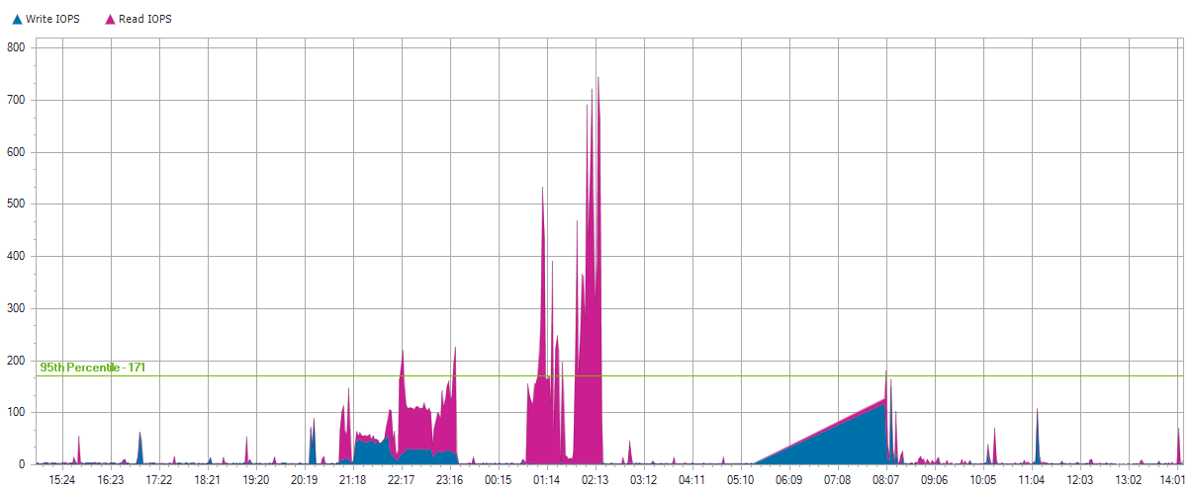
NET2-SAN

Slide 127
NET2-SAN

Slide 128
NET2-SAN

Slide 129
Local Disks for NET2-SAN

Slide 130
0 E:
Server Name | NET2-SAN
Server Operating System | Microsoft Windows Storage Server 2008 Standard Service Pack 1
Total Local Capacity | 75.00 GB
Free Local Capacity | 0 GB (0%)
Used Local Capacity | 75.00 GB (100%)
Peak Throughput | 2.20 MB/s
Average Latency | 1.35 ms Reads and 24.25 ms Writes
IOPS | 8 at 95%
Read/Write Ratio | 86% / 14%
Average IO Size | Read: 5.78 KB / Write: 37.77 KB

Slide 131
0 E:

Slide 132
0 E:

Slide 133
0 E:

Slide 134
1 E:
Server Name | NET2-SAN
Server Operating System | Microsoft Windows Storage Server 2008 Standard Service Pack 1
Total Local Capacity | 575.00 GB
Free Local Capacity | 0 GB (0%)
Used Local Capacity | 575.00 GB (100%)
Peak Throughput | 2.90 MB/s
Average Latency | 2.48 ms Reads and 9.56 ms Writes
IOPS | 78 at 95%
Read/Write Ratio | 98% / 2%
Average IO Size | Read: 4.33 KB / Write: 6.00 KB

Slide 135
1 E:

Slide 136
1 E:

Slide 137
1 E:

Slide 138
2 E:
Server Name | NET2-SAN
Server Operating System | Microsoft Windows Storage Server 2008 Standard Service Pack 1
Total Local Capacity | 175.00 GB
Free Local Capacity | 0 GB (0%)
Used Local Capacity | 175.00 GB (100%)
Peak Throughput | 2.00 MB/s
Average Latency | 2.11 ms Reads and 16.66 ms Writes
IOPS | 4 at 95%
Read/Write Ratio | 96% / 4%
Average IO Size | Read: 6.32 KB / Write: 25.22 KB

Slide 139
2 E:

Slide 140
2 E:

Slide 141
2 E:

Slide 142
3 E:
Server Name | NET2-SAN
Server Operating System | Microsoft Windows Storage Server 2008 Standard Service Pack 1
Total Local Capacity | 200.00 GB
Free Local Capacity | 0 GB (0%)
Used Local Capacity | 200.00 GB (100%)
Peak Throughput | 1.50 MB/s
Average Latency | 2.30 ms Reads and 13.30 ms Writes
IOPS | 7 at 95%
Read/Write Ratio | 90% / 10%
Average IO Size | Read: 6.22 KB / Write: 30.10 KB

Slide 143
3 E:

Slide 144
3 E:

Slide 145
3 E:

Slide 146
4 E:
Server Name | NET2-SAN
Server Operating System | Microsoft Windows Storage Server 2008 Standard Service Pack 1
Total Local Capacity | 67.00 GB
Free Local Capacity | 0 GB (0%)
Used Local Capacity | 67.00 GB (100%)
Peak Throughput | 3.40 MB/s
Average Latency | 2.43 ms Reads and 20.60 ms Writes
IOPS | 15 at 95%
Read/Write Ratio | 70% / 30%
Average IO Size | Read: 4.38 KB / Write: 29.62 KB

Slide 147
4 E:

Slide 148
4 E:

Slide 149
4 E:

Slide 150
5 C:
Server Name | NET2-SAN
Server Operating System | Microsoft Windows Storage Server 2008 Standard Service Pack 1
Total Local Capacity | 40.00 GB
Free Local Capacity | 12.00 GB (30%)
Used Local Capacity | 28.00 GB (70%)
Peak Throughput | 2.60 MB/s
Average Latency | 5.07 ms Reads and 10.79 ms Writes
IOPS | 4 at 95%
Read/Write Ratio | 41% / 59%
Average IO Size | Read: 14.20 KB / Write: 14.97 KB

Slide 151
5 C:

Slide 152
5 C:

Slide 153
5 C:

Slide 154
6
Server Name | NET2-SAN
Server Operating System | Microsoft Windows Storage Server 2008 Standard Service Pack 1
Total Local Capacity | 5.00 GB
Free Local Capacity | 0 GB (0%)
Used Local Capacity | 5.00 GB (100%)
Peak Throughput | 0.00 MB/s
Average Latency | 0.78 ms Reads and 0.00 ms Writes
IOPS | 0 at 95%
Read/Write Ratio | 100% / 0%
Average IO Size | Read: 0.42 KB / Write: 0 KB

Slide 155
6

Slide 156
6

Slide 157
6

Slide 158
7 E:
Server Name | NET2-SAN
Server Operating System | Microsoft Windows Storage Server 2008 Standard Service Pack 1
Total Local Capacity | 92.00 GB
Free Local Capacity | 0 GB (0%)
Used Local Capacity | 92.00 GB (100%)
Peak Throughput | 3.50 MB/s
Average Latency | 1.69 ms Reads and 7.09 ms Writes
IOPS | 38 at 95%
Read/Write Ratio | 79% / 21%
Average IO Size | Read: 5.10 KB / Write: 37.51 KB

Slide 159
7 E:

Slide 160
7 E:

Slide 161
7 E:

Slide 162
KCATA-PS2

Slide 163
KCATA-PS2
Operating System | Microsoft Windows Server 2008 Standard Service Pack 2
Time Recorded | 0 Hour(s), 0 Minute(s), 9/1/2020 - na
IOPS | 78 at 95%
Peak Disk Throughput | 11.20 MB/s
Read/Write Ratio | 84% / 16%
Total Local Capacity | 68.00 GB
Free Local Capacity | 6.00 GB (9%)
Used Local Capacity | 62.00 GB (91%)

Slide 164
KCATA-PS2
Average IO Size | Read: 26.33 KB / Write: 35.31 KB
Average Latency | Read: 5.92 ms / Write: 16.07 ms
Average Queue Depth | 1
Peak/Min CPU | 25% / 6%
Peak/Min Memory | 32.37 MB / 776.00 MB
Peak/Min Memory In Use | 1.97 GB / 1.24 GB
CPU Sockets | 1
CPU Cores | 4
CPU Description | Intel(R) Xeon(R) CPU E5310 @ 1.60GHz

Slide 165
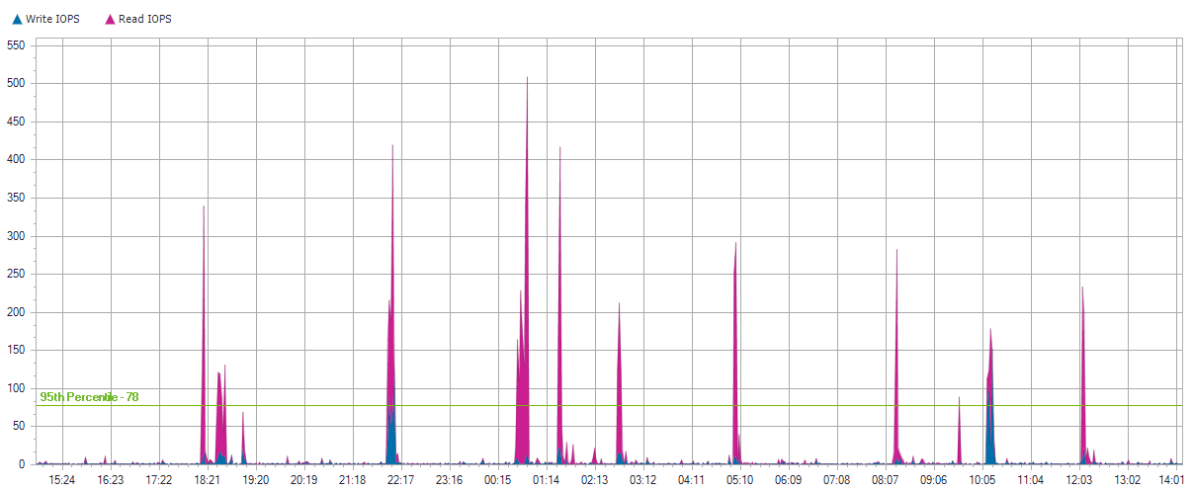
KCATA-PS2

Slide 166
KCATA-PS2

Slide 167
KCATA-PS2

Slide 168
Local Disks for KCATA-PS2

Slide 169
0 C:
Server Name | KCATA-PS2
Server Operating System | Microsoft Windows Server 2008 Standard Service Pack 2
Total Local Capacity | 68.00 GB
Free Local Capacity | 6.00 GB (9%)
Used Local Capacity | 62.00 GB (91%)
Peak Throughput | 11.20 MB/s
Average Latency | 5.92 ms Reads and 16.07 ms Writes
IOPS | 78 at 95%
Read/Write Ratio | 84% / 16%
Average IO Size | Read: 26.33 KB / Write: 35.31 KB

Slide 170
0 C:

Slide 171
0 C:

Slide 172
0 C:

Slide 173
KC-PROBE

Slide 174
KC-PROBE
Operating System | Microsoft Windows 7 Professional Service Pack 1
Time Recorded | 0 Hour(s), 0 Minute(s), 9/1/2020 - na
IOPS | 73 at 95%
Peak Disk Throughput | 12.10 MB/s
Read/Write Ratio | 96% / 4%
Total Local Capacity | 75.00 GB
Free Local Capacity | 8.00 GB (11%)
Used Local Capacity | 67.00 GB (89%)

Slide 175
KC-PROBE
Average IO Size | Read: 34.34 KB / Write: 30.70 KB
Average Latency | Read: 13.87 ms / Write: 4.08 ms
Average Queue Depth | 1
Peak/Min CPU | 9% / 1%
Peak/Min Memory | 1.44 GB / 2.20 GB
Peak/Min Memory In Use | 2.50 GB / 1.74 GB
CPU Sockets | 1
CPU Cores | 4
CPU Description | Intel(R) Core(TM) i7 CPU 870 @ 2.93GHz

Slide 176
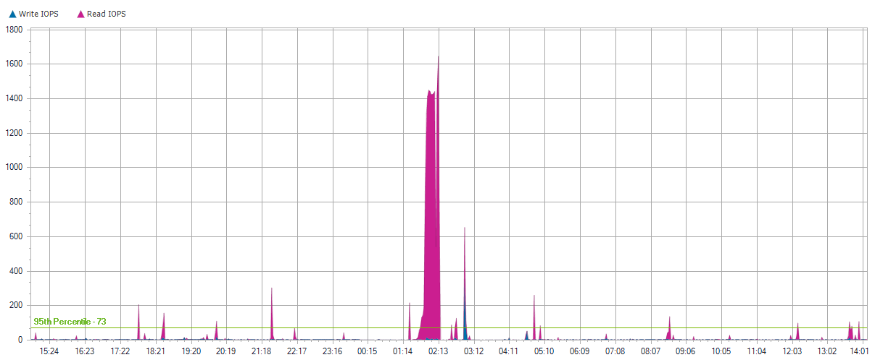
KC-PROBE

Slide 177
KC-PROBE

Slide 178
KC-PROBE

Slide 179
Local Disks for KC-PROBE

Slide 180
0 C: D:
Server Name | KC-PROBE
Server Operating System | Microsoft Windows 7 Professional Service Pack 1
Total Local Capacity | 75.00 GB
Free Local Capacity | 8.00 GB (11%)
Used Local Capacity | 67.00 GB (89%)
Peak Throughput | 12.10 MB/s
Average Latency | 13.87 ms Reads and 4.08 ms Writes
IOPS | 73 at 95%
Read/Write Ratio | 96% / 4%
Average IO Size | Read: 34.34 KB / Write: 30.70 KB

Slide 181
0 C: D:

Slide 182
0 C: D:

Slide 183
0 C: D:

Slide 184
KCATA-FW

Slide 185
KCATA-FW
Operating System | Microsoft Windows Server 2008 R2 Standard Service Pack 1
Time Recorded | 0 Hour(s), 0 Minute(s), 9/1/2020 - na
IOPS | 66 at 95%
Peak Disk Throughput | 24.00 MB/s
Read/Write Ratio | 82% / 18%
Total Local Capacity | 279.00 GB
Free Local Capacity | 173.00 GB (62%)
Used Local Capacity | 106.00 GB (38%)

Slide 186
KCATA-FW
Average IO Size | Read: 27.36 KB / Write: 20.69 KB
Average Latency | Read: 3.43 ms / Write: 11.51 ms
Average Queue Depth | 0
Peak/Min CPU | 10% / 0%
Peak/Min Memory | 5.61 GB / 6.31 GB
Peak/Min Memory In Use | 6.38 GB / 5.68 GB
CPU Sockets | 1
CPU Cores | 6
CPU Description | Intel(R) Xeon(R) CPU X5675 @ 3.07GHz

Slide 187
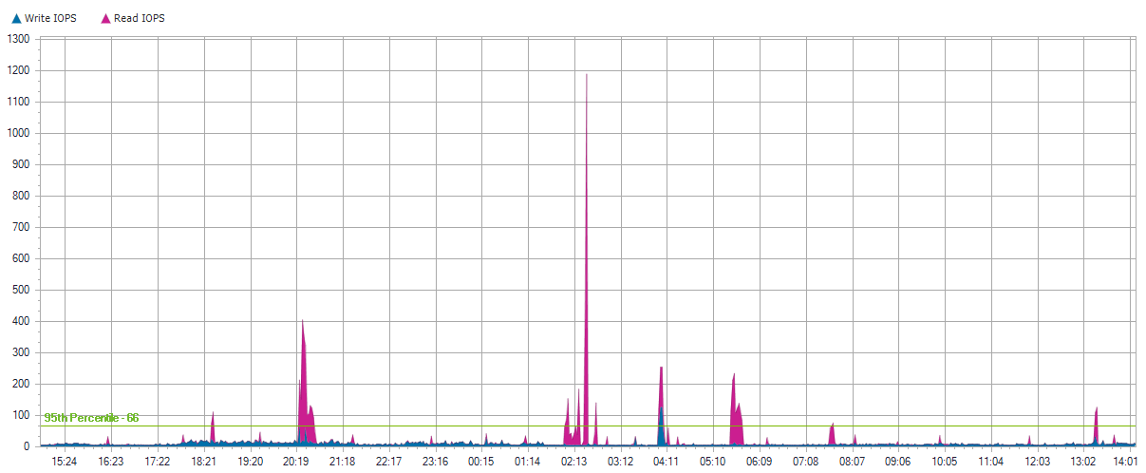
KCATA-FW

Slide 188
KCATA-FW

Slide 189
KCATA-FW

Slide 190
Local Disks for KCATA-FW

Slide 191
0 C:
Server Name | KCATA-FW
Server Operating System | Microsoft Windows Server 2008 R2 Standard Service Pack 1
Total Local Capacity | 279.00 GB
Free Local Capacity | 173.00 GB (62%)
Used Local Capacity | 106.00 GB (38%)
Peak Throughput | 24.00 MB/s
Average Latency | 3.43 ms Reads and 11.51 ms Writes
IOPS | 66 at 95%
Read/Write Ratio | 82% / 18%
Average IO Size | Read: 27.36 KB / Write: 20.69 KB

Slide 192
0 C:

Slide 193
0 C:

Slide 194
0 C:

Slide 195
TMDB1-13

Slide 196
TMDB1-13
Operating System | Microsoft Windows Server 2008 R2 Enterprise Service Pack 1
Time Recorded | 0 Hour(s), 0 Minute(s), 9/1/2020 - na
IOPS | 65 at 95%
Peak Disk Throughput | 45.50 MB/s
Read/Write Ratio | 80% / 20%
Total Local Capacity | 279.00 GB
Free Local Capacity | 142.00 GB (51%)
Used Local Capacity | 137.00 GB (49%)

Slide 197
TMDB1-13
Average IO Size | Read: 212.68 KB / Write: 81.90 KB
Average Latency | Read: 21.00 ms / Write: 16.87 ms
Average Queue Depth | 1
Peak/Min CPU | 21% / 0%
Peak/Min Memory | 4.52 GB / 5.75 GB
Peak/Min Memory In Use | 27.47 GB / 26.24 GB
CPU Sockets | 2
CPU Cores | 8
CPU Description | Intel(R) Xeon(R) CPU E5620 @ 2.40GHz

Slide 198
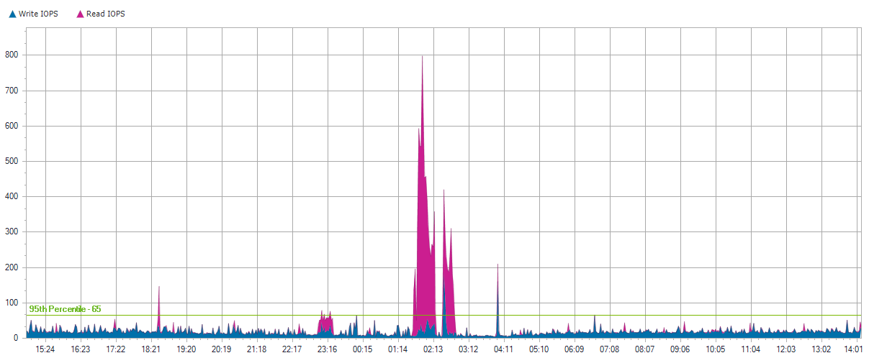
TMDB1-13

Slide 199
TMDB1-13

Slide 200
TMDB1-13

Slide 201
Local Disks for TMDB1-13

Slide 202
0 C:
Server Name | TMDB1-13
Server Operating System | Microsoft Windows Server 2008 R2 Enterprise Service Pack 1
Total Local Capacity | 279.00 GB
Free Local Capacity | 142.00 GB (51%)
Used Local Capacity | 137.00 GB (49%)
Peak Throughput | 4.80 MB/s
Average Latency | 47.05 ms Reads and 10.53 ms Writes
IOPS | 22 at 95%
Read/Write Ratio | 90% / 10%
Average IO Size | Read: 78.29 KB / Write: 24.58 KB

Slide 203
0 C:

Slide 204
0 C:

Slide 205
0 C:

Slide 206
ad89fc7e93fd31208deeb7c9f2b778820000000000
Server Name | TMDB1-13
Server Operating System | Microsoft Windows Server 2008 R2 Enterprise Service Pack 1
Total Local Capacity | 25.00 GB
Free Local Capacity | 0 GB (0%)
Used Local Capacity | 25.00 GB (100%)
Peak Throughput | 0.00 MB/s
Average Latency | 0.09 ms Reads and 4.33 ms Writes
IOPS | 1 at 95%
Read/Write Ratio | 0% / 100%
Average IO Size | Read: 0.01 KB / Write: 5.07 KB

Slide 207
ad89fc7e93fd31208deeb7c9f2b778820000000000

Slide 208
ad89fc7e93fd31208deeb7c9f2b778820000000000

Slide 209
ad89fc7e93fd31208deeb7c9f2b778820000000000

Slide 210
ad89fc7e93fd31208deeb7c9f2b778820000000000
Server Name | TMDB1-13
Server Operating System | Microsoft Windows Server 2008 R2 Enterprise Service Pack 1
Total Local Capacity | 30.00 GB
Free Local Capacity | 0 GB (0%)
Used Local Capacity | 30.00 GB (100%)
Peak Throughput | 0.00 MB/s
Average Latency | 0.09 ms Reads and 0.00 ms Writes
IOPS | 0 at 95%
Read/Write Ratio | 100% / 0%
Average IO Size | Read: 0.02 KB / Write: 0 KB

Slide 211
ad89fc7e93fd31208deeb7c9f2b778820000000000

Slide 212
ad89fc7e93fd31208deeb7c9f2b778820000000000

Slide 213
ad89fc7e93fd31208deeb7c9f2b778820000000000

Slide 214
ad89fc7e93fd31208deeb7c9f2b778820000000000
Server Name | TMDB1-13
Server Operating System | Microsoft Windows Server 2008 R2 Enterprise Service Pack 1
Total Local Capacity | 25.00 GB
Free Local Capacity | 0 GB (0%)
Used Local Capacity | 25.00 GB (100%)
Peak Throughput | 0.00 MB/s
Average Latency | 0.09 ms Reads and 0.00 ms Writes
IOPS | 0 at 95%
Read/Write Ratio | 100% / 0%
Average IO Size | Read: 0.02 KB / Write: 0 KB

Slide 215
ad89fc7e93fd31208deeb7c9f2b778820000000000

Slide 216
ad89fc7e93fd31208deeb7c9f2b778820000000000

Slide 217
ad89fc7e93fd31208deeb7c9f2b778820000000000

Slide 218
ad89fc7e93fd31208deeb7c9f2b778820000000000
Server Name | TMDB1-13
Server Operating System | Microsoft Windows Server 2008 R2 Enterprise Service Pack 1
Total Local Capacity | 400.00 GB
Free Local Capacity | 0 GB (0%)
Used Local Capacity | 400.00 GB (100%)
Peak Throughput | 45.40 MB/s
Average Latency | 17.57 ms Reads and 16.90 ms Writes
IOPS | 37 at 95%
Read/Write Ratio | 50% / 50%
Average IO Size | Read: 211.01 KB / Write: 91.13 KB

Slide 219
ad89fc7e93fd31208deeb7c9f2b778820000000000

Slide 220
ad89fc7e93fd31208deeb7c9f2b778820000000000

Slide 221
ad89fc7e93fd31208deeb7c9f2b778820000000000

Slide 222
TMDC3

Slide 223
TMDC3
Operating System | Microsoft Windows Server 2012 R2 Standard
Time Recorded | 0 Hour(s), 0 Minute(s), 9/1/2020 - na
IOPS | 58 at 95%
Peak Disk Throughput | 9.00 MB/s
Read/Write Ratio | 83% / 17%
Total Local Capacity | 68.00 GB
Free Local Capacity | 50.00 GB (74%)
Used Local Capacity | 18.00 GB (26%)

Slide 224
TMDC3
Average IO Size | Read: 42.83 KB / Write: 11.74 KB
Average Latency | Read: 5.10 ms / Write: 11.35 ms
Average Queue Depth | 0
Peak/Min CPU | 29% / 0%
Peak/Min Memory | 7.88 GB / 10.42 GB
Peak/Min Memory In Use | 4.12 GB / 1.58 GB
CPU Sockets | 1
CPU Cores | 4
CPU Description | Intel(R) Xeon(R) CPU E5310 @ 1.60GHz

Slide 225
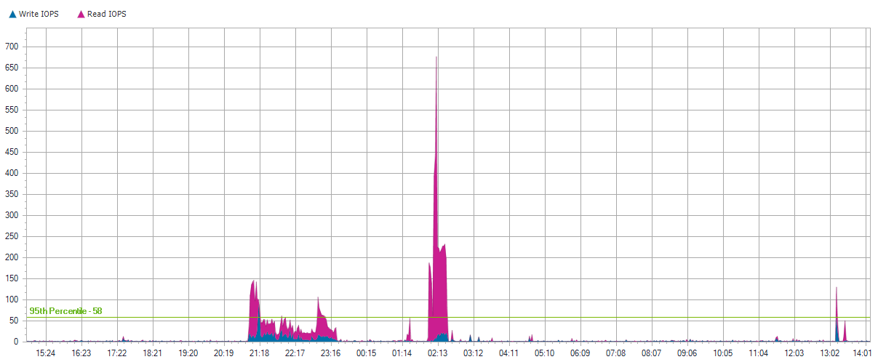
TMDC3

Slide 226
TMDC3

Slide 227
TMDC3

Slide 228
Local Disks for TMDC3

Slide 229
0 C:
Server Name | TMDC3
Server Operating System | Microsoft Windows Server 2012 R2 Standard
Total Local Capacity | 68.00 GB
Free Local Capacity | 50.00 GB (74%)
Used Local Capacity | 18.00 GB (26%)
Peak Throughput | 9.00 MB/s
Average Latency | 5.10 ms Reads and 11.35 ms Writes
IOPS | 58 at 95%
Read/Write Ratio | 83% / 17%
Average IO Size | Read: 42.83 KB / Write: 11.74 KB

Slide 230
0 C:

Slide 231
0 C:

Slide 232
0 C:

Slide 233
KCNAV

Slide 234
KCNAV
Operating System | Microsoft(R) Windows(R) Server 2003 Standard Edition Service Pack 2
Time Recorded | 0 Hour(s), 0 Minute(s), 9/1/2020 - na
IOPS | 51 at 95%
Peak Disk Throughput | 47.60 MB/s
Read/Write Ratio | 53% / 47%
Total Local Capacity | 232.00 GB
Free Local Capacity | 59.00 GB (25%)
Used Local Capacity | 173.00 GB (75%)

Slide 235
KCNAV
Average IO Size | Read: 839.28 KB / Write: 531.10 KB
Average Latency | Read: 0.27 ms / Write: 0.53 ms
Average Queue Depth | 1
Peak/Min CPU | 8% / 1%
Peak/Min Memory | 225.84 MB / 249.82 MB
Peak/Min Memory In Use | 1.78 GB / 1.76 GB
CPU Sockets | 4
CPU Cores | 4
CPU Description | Intel(R) Xeon(TM) CPU 3.60GHz

Slide 236
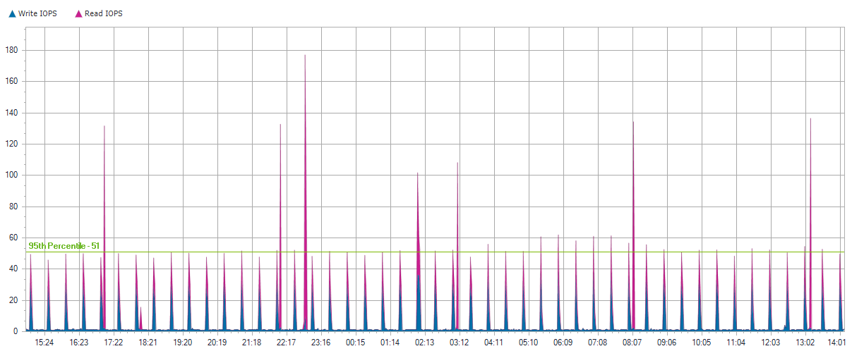
KCNAV

Slide 237
KCNAV

Slide 238
KCNAV

Slide 239
Local Disks for KCNAV

Slide 240
0 C:
Server Name | KCNAV
Server Operating System | Microsoft(R) Windows(R) Server 2003 Standard Edition Service Pack 2
Total Local Capacity | 34.00 GB
Free Local Capacity | 1.00 GB (3%)
Used Local Capacity | 33.00 GB (97%)
Peak Throughput | 4.10 MB/s
Average Latency | 0.23 ms Reads and 1.82 ms Writes
IOPS | 2 at 95%
Read/Write Ratio | 85% / 15%
Average IO Size | Read: 6.57 KB / Write: 6.28 KB

Slide 241
0 C:

Slide 242
0 C:

Slide 243
0 C:

Slide 244
PB9840TX3UZ074-45054293
Server Name | KCNAV
Server Operating System | Microsoft(R) Windows(R) Server 2003 Standard Edition Service Pack 2
Total Local Capacity | 99.00 GB
Free Local Capacity | 4.00 GB (4%)
Used Local Capacity | 95.00 GB (96%)
Peak Throughput | 23.80 MB/s
Average Latency | 0.01 ms Reads and 0.20 ms Writes
IOPS | 30 at 95%
Read/Write Ratio | 6% / 94%
Average IO Size | Read: 1.78 KB / Write: 623.90 KB

Slide 245
PB9840TX3UZ074-45054293

Slide 246
PB9840TX3UZ074-45054293

Slide 247
PB9840TX3UZ074-45054293

Slide 248
PB9840TX3UZ074-4505428c
Server Name | KCNAV
Server Operating System | Microsoft(R) Windows(R) Server 2003 Standard Edition Service Pack 2
Total Local Capacity | 99.00 GB
Free Local Capacity | 54.00 GB (55%)
Used Local Capacity | 45.00 GB (45%)
Peak Throughput | 23.80 MB/s
Average Latency | 0.31 ms Reads and 0.02 ms Writes
IOPS | 19 at 95%
Read/Write Ratio | 100% / 0%
Average IO Size | Read: 942.71 KB / Write: 0.17 KB

Slide 249
PB9840TX3UZ074-4505428c

Slide 250
PB9840TX3UZ074-4505428c

Slide 251
PB9840TX3UZ074-4505428c

Slide 252
KCATADASHBOARD

Slide 253
KCATADASHBOARD
Operating System | Microsoft Windows 10 Pro
Time Recorded | 0 Hour(s), 0 Minute(s), 9/1/2020 - na
IOPS | 51 at 95%
Peak Disk Throughput | 44.10 MB/s
Read/Write Ratio | 88% / 12%
Total Local Capacity | 1.37 TB
Free Local Capacity | 122.00 GB (9%)
Used Local Capacity | 1.25 TB (91%)

Slide 254
KCATADASHBOARD
Average IO Size | Read: 27.33 KB / Write: 162.31 KB
Average Latency | Read: 6.04 ms / Write: 3.69 ms
Average Queue Depth | 0
Peak/Min CPU | 25% / 0%
Peak/Min Memory | 3.19 GB / 4.16 GB
Peak/Min Memory In Use | 4.69 GB / 3.72 GB
CPU Sockets | 1
CPU Cores | 4
CPU Description | Intel(R) Core(TM) i7-3770 CPU @ 3.40GHz

Slide 255
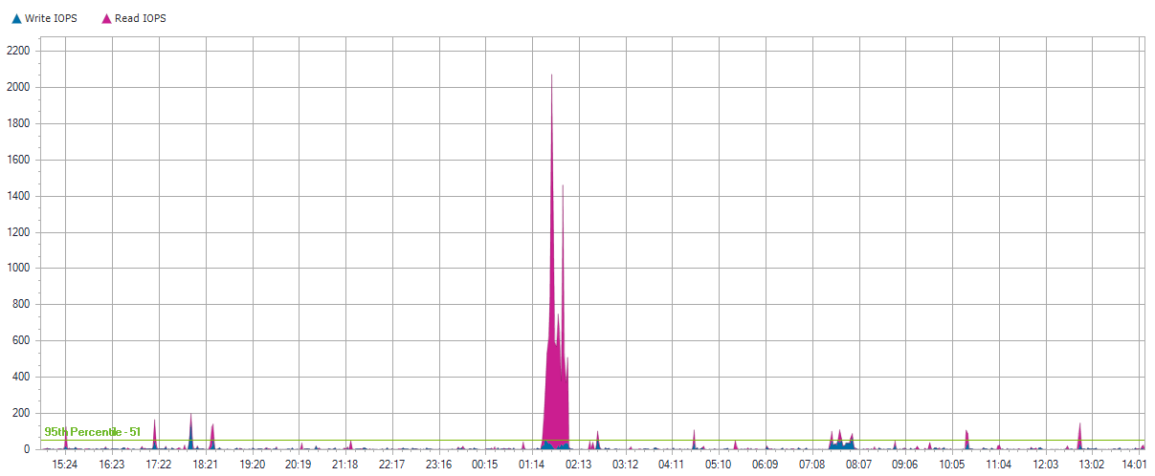
KCATADASHBOARD

Slide 256
KCATADASHBOARD

Slide 257
KCATADASHBOARD

Slide 258
Local Disks for KCATADASHBOARD

Slide 259
0 C: D:
Server Name | KCATADASHBOARD
Server Operating System | Microsoft Windows 10 Pro
Total Local Capacity | 466.00 GB
Free Local Capacity | 33.00 GB (7%)
Used Local Capacity | 433.00 GB (93%)
Peak Throughput | 31.10 MB/s
Average Latency | 4.90 ms Reads and 2.42 ms Writes
IOPS | 48 at 95%
Read/Write Ratio | 90% / 10%
Average IO Size | Read: 28.44 KB / Write: 21.10 KB

Slide 260
0 C: D:

Slide 261
0 C: D:

Slide 262
0 C: D:

Slide 263
1 E: F: H:
Server Name | KCATADASHBOARD
Server Operating System | Microsoft Windows 10 Pro
Total Local Capacity | 932.00 GB
Free Local Capacity | 89.00 GB (10%)
Used Local Capacity | 843.00 GB (90%)
Peak Throughput | 44.00 MB/s
Average Latency | 0.16 ms Reads and 2.77 ms Writes
IOPS | 0 at 95%
Read/Write Ratio | 1% / 99%
Average IO Size | Read: 0.15 KB / Write: 224.49 KB

Slide 264
1 E: F: H:

Slide 265
1 E: F: H:

Slide 266
1 E: F: H:

Slide 267
KCSQLP2

Slide 268
KCSQLP2
Operating System | Microsoft Windows Server 2012 Standard
Time Recorded | 0 Hour(s), 0 Minute(s), 9/1/2020 - na
IOPS | 45 at 95%
Peak Disk Throughput | 61.00 MB/s
Read/Write Ratio | 91% / 9%
Total Local Capacity | 279.00 GB
Free Local Capacity | 99.00 GB (35%)
Used Local Capacity | 180.00 GB (65%)

Slide 269
KCSQLP2
Average IO Size | Read: 43.69 KB / Write: 29.55 KB
Average Latency | Read: 1.77 ms / Write: 0.13 ms
Average Queue Depth | 0
Peak/Min CPU | 17% / 0%
Peak/Min Memory | 27.07 GB / 27.46 GB
Peak/Min Memory In Use | 4.90 GB / 4.51 GB
CPU Sockets | 2
CPU Cores | 8
CPU Description | Intel(R) Xeon(R) CPU E5-2609 0 @ 2.40GHz

Slide 270
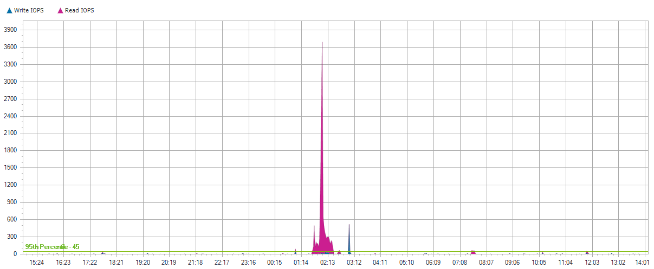
KCSQLP2

Slide 271
KCSQLP2

Slide 272
KCSQLP2

Slide 273
Local Disks for KCSQLP2

Slide 274
0 C:
Server Name | KCSQLP2
Server Operating System | Microsoft Windows Server 2012 Standard
Total Local Capacity | 279.00 GB
Free Local Capacity | 99.00 GB (35%)
Used Local Capacity | 180.00 GB (65%)
Peak Throughput | 61.00 MB/s
Average Latency | 1.77 ms Reads and 0.13 ms Writes
IOPS | 45 at 95%
Read/Write Ratio | 91% / 9%
Average IO Size | Read: 43.69 KB / Write: 29.55 KB

Slide 275
0 C:

Slide 276
0 C:

Slide 277
0 C:

Slide 278
KC-TSRV

Slide 279
KC-TSRV
Operating System | Microsoft Windows Server 2008 R2 Standard Service Pack 1
Time Recorded | 0 Hour(s), 0 Minute(s), 9/1/2020 - na
IOPS | 41 at 95%
Peak Disk Throughput | 9.80 MB/s
Read/Write Ratio | 92% / 8%
Total Local Capacity | 279.00 GB
Free Local Capacity | 124.00 GB (44%)
Used Local Capacity | 155.00 GB (56%)

Slide 280
KC-TSRV
Average IO Size | Read: 22.63 KB / Write: 24.30 KB
Average Latency | Read: 3.14 ms / Write: 16.83 ms
Average Queue Depth | 0
Peak/Min CPU | 8% / 0%
Peak/Min Memory | 14.99 GB / 16.15 GB
Peak/Min Memory In Use | 5.00 GB / 3.84 GB
CPU Sockets | 1
CPU Cores | 6
CPU Description | Intel(R) Xeon(R) CPU X5675 @ 3.07GHz

Slide 281
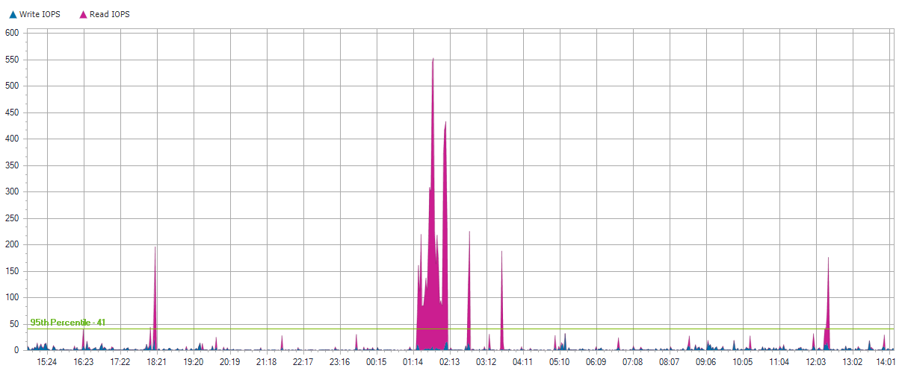
KC-TSRV

Slide 282
KC-TSRV

Slide 283
KC-TSRV

Slide 284
Local Disks for KC-TSRV

Slide 285
0 C:
Server Name | KC-TSRV
Server Operating System | Microsoft Windows Server 2008 R2 Standard Service Pack 1
Total Local Capacity | 279.00 GB
Free Local Capacity | 124.00 GB (44%)
Used Local Capacity | 155.00 GB (56%)
Peak Throughput | 9.80 MB/s
Average Latency | 3.14 ms Reads and 16.83 ms Writes
IOPS | 41 at 95%
Read/Write Ratio | 92% / 8%
Average IO Size | Read: 22.63 KB / Write: 24.30 KB

Slide 286
0 C:

Slide 287
0 C:

Slide 288
0 C:

Slide 289
TMDB2-13

Slide 290
TMDB2-13
Operating System | Microsoft Windows Server 2008 R2 Enterprise Service Pack 1
Time Recorded | 0 Hour(s), 0 Minute(s), 9/1/2020 - na
IOPS | 37 at 95%
Peak Disk Throughput | 13.50 MB/s
Read/Write Ratio | 76% / 24%
Total Local Capacity | 279.00 GB
Free Local Capacity | 161.00 GB (58%)
Used Local Capacity | 118.00 GB (42%)

Slide 291
TMDB2-13
Average IO Size | Read: 23.17 KB / Write: 24.95 KB
Average Latency | Read: 3.08 ms / Write: 7.07 ms
Average Queue Depth | 0
Peak/Min CPU | 9% / 0%
Peak/Min Memory | 27.55 GB / 28.40 GB
Peak/Min Memory In Use | 4.44 GB / 3.59 GB
CPU Sockets | 2
CPU Cores | 8
CPU Description | Intel(R) Xeon(R) CPU E5620 @ 2.40GHz

Slide 292
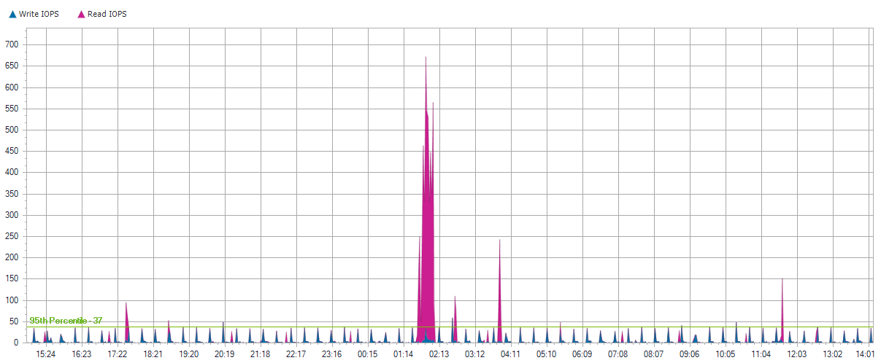
TMDB2-13

Slide 293
TMDB2-13

Slide 294
TMDB2-13

Slide 295
Local Disks for TMDB2-13

Slide 296
0 C:
Server Name | TMDB2-13
Server Operating System | Microsoft Windows Server 2008 R2 Enterprise Service Pack 1
Total Local Capacity | 279.00 GB
Free Local Capacity | 161.00 GB (58%)
Used Local Capacity | 118.00 GB (42%)
Peak Throughput | 13.50 MB/s
Average Latency | 3.13 ms Reads and 7.07 ms Writes
IOPS | 37 at 95%
Read/Write Ratio | 76% / 24%
Average IO Size | Read: 27.51 KB / Write: 24.95 KB

Slide 297
0 C:

Slide 298
0 C:

Slide 299
0 C:

Slide 300
ad89fc7e93fd31208deeb7c9f2b778820000000000
Server Name | TMDB2-13
Server Operating System | Microsoft Windows Server 2008 R2 Enterprise Service Pack 1
Total Local Capacity | 25.00 GB
Free Local Capacity | 0 GB (0%)
Used Local Capacity | 25.00 GB (100%)
Peak Throughput | 0.00 MB/s
Average Latency | 0.00 ms Reads and 0.00 ms Writes
IOPS | 0 at 95%
Read/Write Ratio | 0% / 100%
Average IO Size | Read: 0 KB / Write: 0 KB

Slide 301
ad89fc7e93fd31208deeb7c9f2b778820000000000

Slide 302
ad89fc7e93fd31208deeb7c9f2b778820000000000

Slide 303
ad89fc7e93fd31208deeb7c9f2b778820000000000

Slide 304
ad89fc7e93fd31208deeb7c9f2b778820000000000
Server Name | TMDB2-13
Server Operating System | Microsoft Windows Server 2008 R2 Enterprise Service Pack 1
Total Local Capacity | 400.00 GB
Free Local Capacity | 0 GB (0%)
Used Local Capacity | 400.00 GB (100%)
Peak Throughput | 0.00 MB/s
Average Latency | 0.21 ms Reads and 0.00 ms Writes
IOPS | 0 at 95%
Read/Write Ratio | 100% / 0%
Average IO Size | Read: 0.10 KB / Write: 0 KB

Slide 305
ad89fc7e93fd31208deeb7c9f2b778820000000000

Slide 306
ad89fc7e93fd31208deeb7c9f2b778820000000000

Slide 307
ad89fc7e93fd31208deeb7c9f2b778820000000000

Slide 308
ad89fc7e93fd31208deeb7c9f2b778820000000000
Server Name | TMDB2-13
Server Operating System | Microsoft Windows Server 2008 R2 Enterprise Service Pack 1
Total Local Capacity | 30.00 GB
Free Local Capacity | 0 GB (0%)
Used Local Capacity | 30.00 GB (100%)
Peak Throughput | 0.00 MB/s
Average Latency | 0.19 ms Reads and 0.00 ms Writes
IOPS | 0 at 95%
Read/Write Ratio | 100% / 0%
Average IO Size | Read: 0.10 KB / Write: 0 KB

Slide 309
ad89fc7e93fd31208deeb7c9f2b778820000000000

Slide 310
ad89fc7e93fd31208deeb7c9f2b778820000000000

Slide 311
ad89fc7e93fd31208deeb7c9f2b778820000000000

Slide 312
ad89fc7e93fd31208deeb7c9f2b778820000000000
Server Name | TMDB2-13
Server Operating System | Microsoft Windows Server 2008 R2 Enterprise Service Pack 1
Total Local Capacity | 25.00 GB
Free Local Capacity | 0 GB (0%)
Used Local Capacity | 25.00 GB (100%)
Peak Throughput | 0.00 MB/s
Average Latency | 2.75 ms Reads and 0.00 ms Writes
IOPS | 0 at 95%
Read/Write Ratio | 100% / 0%
Average IO Size | Read: 0.68 KB / Write: 0 KB

Slide 313
ad89fc7e93fd31208deeb7c9f2b778820000000000

Slide 314
ad89fc7e93fd31208deeb7c9f2b778820000000000

Slide 315
ad89fc7e93fd31208deeb7c9f2b778820000000000

Slide 316
KC-EXCHANGE

Slide 317
KC-EXCHANGE
Operating System | Microsoft Windows Server 2008 R2 Standard Service Pack 1
Time Recorded | 0 Hour(s), 0 Minute(s), 9/1/2020 - na
IOPS | 36 at 95%
Peak Disk Throughput | 21.70 MB/s
Read/Write Ratio | 96% / 4%
Total Local Capacity | 447.00 GB
Free Local Capacity | 60.00 GB (13%)
Used Local Capacity | 387.00 GB (87%)

Slide 318
KC-EXCHANGE
Average IO Size | Read: 163.44 KB / Write: 22.04 KB
Average Latency | Read: 1.20 ms / Write: 0.30 ms
Average Queue Depth | 0
Peak/Min CPU | 10% / 0%
Peak/Min Memory | 1.40 GB / 2.08 GB
Peak/Min Memory In Use | 14.59 GB / 13.91 GB
CPU Sockets | 2
CPU Cores | 8
CPU Description | Intel(R) Xeon(R) CPU E5630 @ 2.53GHz

Slide 319
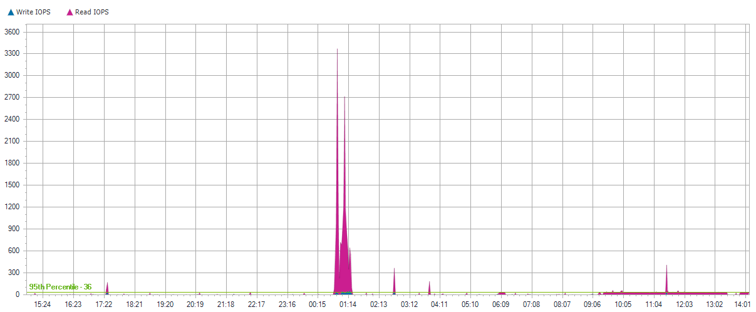
KC-EXCHANGE

Slide 320
KC-EXCHANGE

Slide 321
KC-EXCHANGE

Slide 322
Local Disks for KC-EXCHANGE

Slide 323
0 C: D:
Server Name | KC-EXCHANGE
Server Operating System | Microsoft Windows Server 2008 R2 Standard Service Pack 1
Total Local Capacity | 447.00 GB
Free Local Capacity | 60.00 GB (13%)
Used Local Capacity | 387.00 GB (87%)
Peak Throughput | 21.70 MB/s
Average Latency | 1.20 ms Reads and 0.30 ms Writes
IOPS | 36 at 95%
Read/Write Ratio | 96% / 4%
Average IO Size | Read: 163.44 KB / Write: 22.04 KB

Slide 324
0 C: D:

Slide 325
0 C: D:

Slide 326
0 C: D:

Slide 327
KC-TMRD

Slide 328
KC-TMRD
Operating System | Microsoft Windows Server 2008 R2 Standard Service Pack 1
Time Recorded | 0 Hour(s), 0 Minute(s), 9/1/2020 - na
IOPS | 36 at 95%
Peak Disk Throughput | 10.10 MB/s
Read/Write Ratio | 90% / 10%
Total Local Capacity | 279.00 GB
Free Local Capacity | 32.00 GB (11%)
Used Local Capacity | 247.00 GB (89%)

Slide 329
KC-TMRD
Average IO Size | Read: 25.79 KB / Write: 30.67 KB
Average Latency | Read: 4.09 ms / Write: 22.10 ms
Average Queue Depth | 1
Peak/Min CPU | 12% / 1%
Peak/Min Memory | 11.84 GB / 18.46 GB
Peak/Min Memory In Use | 16.15 GB / 9.53 GB
CPU Sockets | 1
CPU Cores | 6
CPU Description | Intel(R) Xeon(R) CPU X5675 @ 3.07GHz

Slide 330
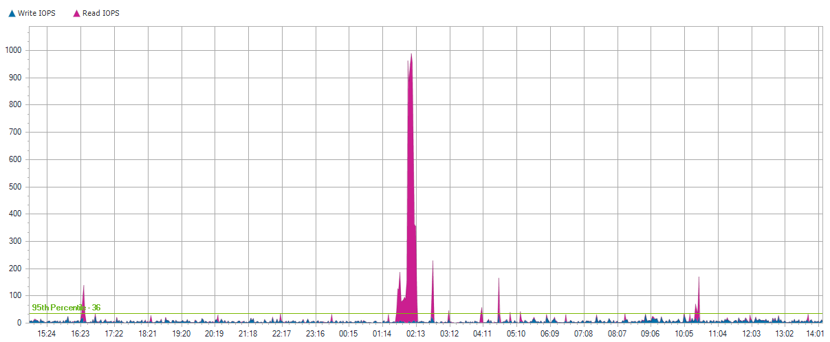
KC-TMRD

Slide 331
KC-TMRD

Slide 332
KC-TMRD

Slide 333
Local Disks for KC-TMRD

Slide 334
0 C:
Server Name | KC-TMRD
Server Operating System | Microsoft Windows Server 2008 R2 Standard Service Pack 1
Total Local Capacity | 279.00 GB
Free Local Capacity | 32.00 GB (11%)
Used Local Capacity | 247.00 GB (89%)
Peak Throughput | 10.10 MB/s
Average Latency | 4.09 ms Reads and 22.10 ms Writes
IOPS | 36 at 95%
Read/Write Ratio | 90% / 10%
Average IO Size | Read: 25.79 KB / Write: 30.67 KB

Slide 335
0 C:

Slide 336
0 C:

Slide 337
0 C:

Slide 338
KCHAST-APPS

Slide 339
KCHAST-APPS
Operating System | Microsoft Windows Server 2008 R2 Standard Service Pack 1
Time Recorded | 0 Hour(s), 0 Minute(s), 9/1/2020 - na
IOPS | 35 at 95%
Peak Disk Throughput | 12.80 MB/s
Read/Write Ratio | 76% / 24%
Total Local Capacity | 279.00 GB
Free Local Capacity | 147.00 GB (53%)
Used Local Capacity | 132.00 GB (47%)

Slide 340
KCHAST-APPS
Average IO Size | Read: 23.90 KB / Write: 24.62 KB
Average Latency | Read: 1.72 ms / Write: 0.07 ms
Average Queue Depth | 0
Peak/Min CPU | 32% / 0%
Peak/Min Memory | 20.28 GB / 25.78 GB
Peak/Min Memory In Use | 11.69 GB / 6.18 GB
CPU Sockets | 2
CPU Cores | 8
CPU Description | Intel(R) Xeon(R) CPU E5-2609 0 @ 2.40GHz

Slide 341
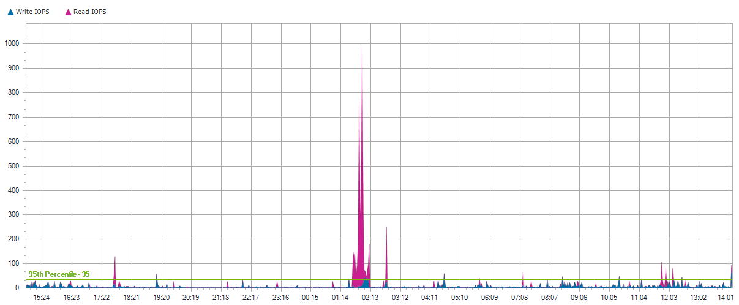
KCHAST-APPS

Slide 342
KCHAST-APPS

Slide 343
KCHAST-APPS

Slide 344
Local Disks for KCHAST-APPS

Slide 345
0 C:
Server Name | KCHAST-APPS
Server Operating System | Microsoft Windows Server 2008 R2 Standard Service Pack 1
Total Local Capacity | 279.00 GB
Free Local Capacity | 147.00 GB (53%)
Used Local Capacity | 132.00 GB (47%)
Peak Throughput | 12.80 MB/s
Average Latency | 1.72 ms Reads and 0.07 ms Writes
IOPS | 35 at 95%
Read/Write Ratio | 76% / 24%
Average IO Size | Read: 23.90 KB / Write: 24.62 KB

Slide 346
0 C:

Slide 347
0 C:

Slide 348
0 C:

Slide 349
KCSQLP-NEW

Slide 350
KCSQLP-NEW
Operating System | Microsoft Windows Server 2008 R2 Standard Service Pack 1
Time Recorded | 0 Hour(s), 0 Minute(s), 9/1/2020 - na
IOPS | 27 at 95%
Peak Disk Throughput | 12.30 MB/s
Read/Write Ratio | 81% / 19%
Total Local Capacity | 625.00 GB
Free Local Capacity | 249.00 GB (40%)
Used Local Capacity | 376.00 GB (60%)

Slide 351
KCSQLP-NEW
Average IO Size | Read: 26.92 KB / Write: 27.41 KB
Average Latency | Read: 6.53 ms / Write: 14.29 ms
Average Queue Depth | 0
Peak/Min CPU | 25% / 0%
Peak/Min Memory | 7.81 GB / 8.07 GB
Peak/Min Memory In Use | 8.19 GB / 7.93 GB
CPU Sockets | 2
CPU Cores | 8
CPU Description | Intel(R) Xeon(R) CPU E5310 @ 1.60GHz

Slide 352
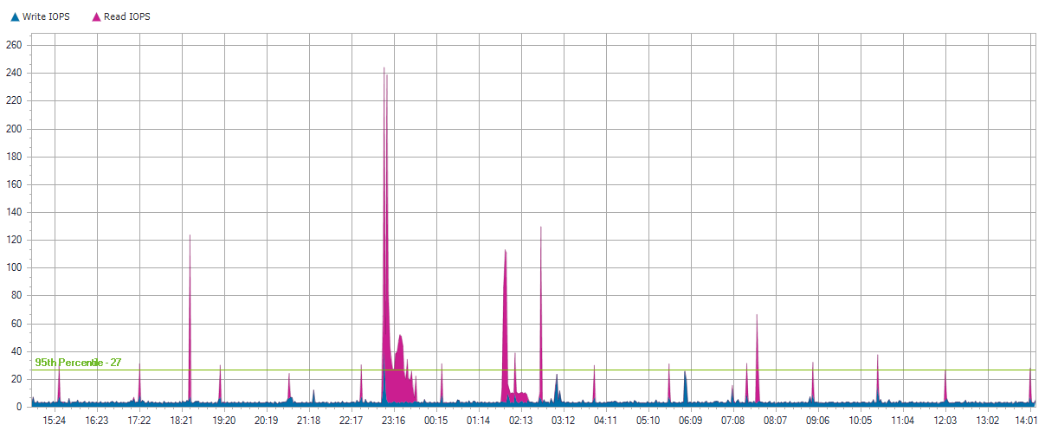
KCSQLP-NEW

Slide 353
KCSQLP-NEW

Slide 354
KCSQLP-NEW

Slide 355
Local Disks for KCSQLP-NEW

Slide 356
0 C:
Server Name | KCSQLP-NEW
Server Operating System | Microsoft Windows Server 2008 R2 Standard Service Pack 1
Total Local Capacity | 137.00 GB
Free Local Capacity | 15.00 GB (11%)
Used Local Capacity | 122.00 GB (89%)
Peak Throughput | 6.40 MB/s
Average Latency | 3.13 ms Reads and 13.97 ms Writes
IOPS | 26 at 95%
Read/Write Ratio | 82% / 18%
Average IO Size | Read: 13.58 KB / Write: 22.54 KB

Slide 357
0 C:

Slide 358
0 C:

Slide 359
0 C:

Slide 360
A294FF2EFD5E4133A8B6C610A884F8E8-6e99c853
Server Name | KCSQLP-NEW
Server Operating System | Microsoft Windows Server 2008 R2 Standard Service Pack 1
Total Local Capacity | 488.00 GB
Free Local Capacity | 234.00 GB (48%)
Used Local Capacity | 254.00 GB (52%)
Peak Throughput | 12.30 MB/s
Average Latency | 6.74 ms Reads and 14.25 ms Writes
IOPS | 1 at 95%
Read/Write Ratio | 69% / 31%
Average IO Size | Read: 21.62 KB / Write: 16.77 KB

Slide 361
A294FF2EFD5E4133A8B6C610A884F8E8-6e99c853

Slide 362
A294FF2EFD5E4133A8B6C610A884F8E8-6e99c853

Slide 363
A294FF2EFD5E4133A8B6C610A884F8E8-6e99c853

Slide 364
KCSQLMHC

Slide 365
KCSQLMHC
Operating System | Microsoft Windows Server 2008 R2 Standard Service Pack 1
Time Recorded | 0 Hour(s), 0 Minute(s), 9/1/2020 - na
IOPS | 26 at 95%
Peak Disk Throughput | 6.50 MB/s
Read/Write Ratio | 91% / 9%
Total Local Capacity | 273.00 GB
Free Local Capacity | 134.00 GB (49%)
Used Local Capacity | 139.00 GB (51%)

Slide 366
KCSQLMHC
Average IO Size | Read: 55.94 KB / Write: 37.73 KB
Average Latency | Read: 60.21 ms / Write: 21.01 ms
Average Queue Depth | 0
Peak/Min CPU | 6% / 0%
Peak/Min Memory | 18.50 GB / 18.96 GB
Peak/Min Memory In Use | 5.49 GB / 5.03 GB
CPU Sockets | 2
CPU Cores | 8
CPU Description | Intel(R) Xeon(R) CPU E5520 @ 2.27GHz

Slide 367
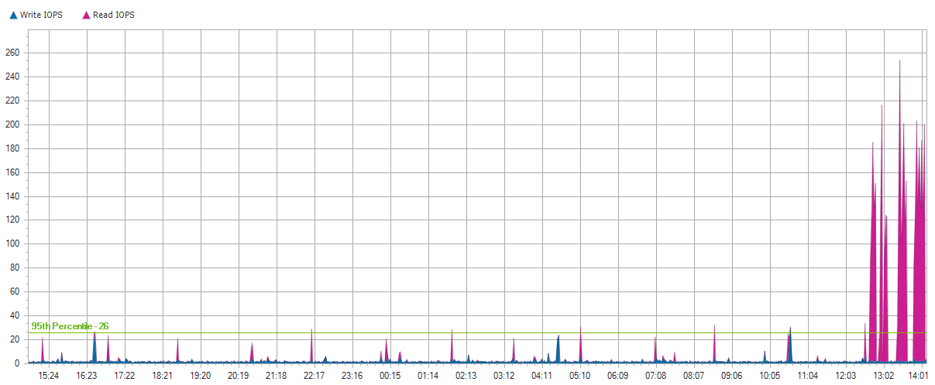
KCSQLMHC

Slide 368
KCSQLMHC

Slide 369
KCSQLMHC

Slide 370
Local Disks for KCSQLMHC

Slide 371
0 C:
Server Name | KCSQLMHC
Server Operating System | Microsoft Windows Server 2008 R2 Standard Service Pack 1
Total Local Capacity | 273.00 GB
Free Local Capacity | 134.00 GB (49%)
Used Local Capacity | 139.00 GB (51%)
Peak Throughput | 6.50 MB/s
Average Latency | 60.21 ms Reads and 21.01 ms Writes
IOPS | 26 at 95%
Read/Write Ratio | 91% / 9%
Average IO Size | Read: 55.94 KB / Write: 37.73 KB

Slide 372
0 C:

Slide 373
0 C:

Slide 374
0 C:

Slide 375
STORAGENODE-1

Slide 376
STORAGENODE-1
Operating System | Microsoft(R) Windows(R) Server 2003 Standard Edition Service Pack 2
Time Recorded | 0 Hour(s), 0 Minute(s), 9/1/2020 - na
IOPS | 23 at 95%
Peak Disk Throughput | 3.70 MB/s
Read/Write Ratio | 90% / 10%
Total Local Capacity | 680.00 GB
Free Local Capacity | 17.00 GB (3%)
Used Local Capacity | 663.00 GB (98%)

Slide 377
STORAGENODE-1
Average IO Size | Read: 5.92 KB / Write: 33.28 KB
Average Latency | Read: 1.32 ms / Write: 5.39 ms
Average Queue Depth | 0
Peak/Min CPU | 5% / 0%
Peak/Min Memory | 1.12 GB / 1.16 GB
Peak/Min Memory In Use | 903.88 MB / 855.96 MB
CPU Sockets | 4
CPU Cores | 4
CPU Description | Intel(R) Xeon(R) CPU E5345 @ 2.33GHz

Slide 378
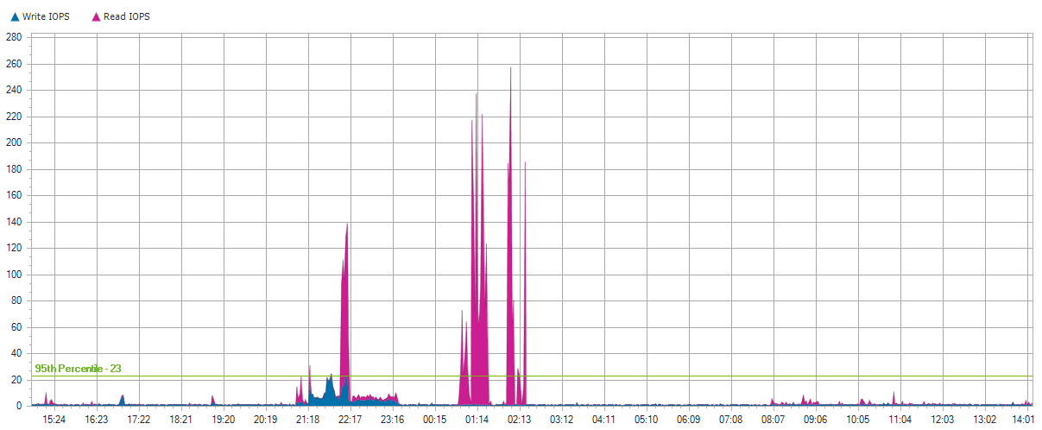
STORAGENODE-1

Slide 379
STORAGENODE-1

Slide 380
STORAGENODE-1

Slide 381
Local Disks for STORAGENODE-1

Slide 382
0 C:
Server Name | STORAGENODE-1
Server Operating System | Microsoft(R) Windows(R) Server 2003 Standard Edition Service Pack 2
Total Local Capacity | 30.00 GB
Free Local Capacity | 17.00 GB (57%)
Used Local Capacity | 13.00 GB (43%)
Peak Throughput | 0.00 MB/s
Average Latency | 0.11 ms Reads and 6.55 ms Writes
IOPS | 2 at 95%
Read/Write Ratio | 11% / 89%
Average IO Size | Read: 1.67 KB / Write: 5.60 KB

Slide 383
0 C:

Slide 384
0 C:

Slide 385
0 C:

Slide 386
1
Server Name | STORAGENODE-1
Server Operating System | Microsoft(R) Windows(R) Server 2003 Standard Edition Service Pack 2
Total Local Capacity | 103.00 GB
Free Local Capacity | 0 GB (0%)
Used Local Capacity | 103.00 GB (100%)
Peak Throughput | 0.00 MB/s
Average Latency | 0.00 ms Reads and 0.00 ms Writes
IOPS | 0 at 95%
Read/Write Ratio | 0% / 100%
Average IO Size | Read: 0 KB / Write: 0 KB

Slide 387
1

Slide 388
1

Slide 389
1

Slide 390
2 D:
Server Name | STORAGENODE-1
Server Operating System | Microsoft(R) Windows(R) Server 2003 Standard Edition Service Pack 2
Total Local Capacity | 547.00 GB
Free Local Capacity | 0 GB (0%)
Used Local Capacity | 547.00 GB (100%)
Peak Throughput | 3.70 MB/s
Average Latency | 1.36 ms Reads and 1.72 ms Writes
IOPS | 21 at 95%
Read/Write Ratio | 91% / 9%
Average IO Size | Read: 5.69 KB / Write: 40.75 KB

Slide 391
2 D:

Slide 392
2 D:

Slide 393
2 D:

Slide 394
BAS-SERV

Slide 395
BAS-SERV
Operating System | Microsoft Windows 10 Pro
Time Recorded | 0 Hour(s), 0 Minute(s), 9/1/2020 - na
IOPS | 14 at 95%
Peak Disk Throughput | 13.30 MB/s
Read/Write Ratio | 93% / 7%
Total Local Capacity | 238.00 GB
Free Local Capacity | 181.00 GB (76%)
Used Local Capacity | 57.00 GB (24%)

Slide 396
BAS-SERV
Average IO Size | Read: 13.49 KB / Write: 12.25 KB
Average Latency | Read: 0.40 ms / Write: 0.55 ms
Average Queue Depth | 0
Peak/Min CPU | 23% / 1%
Peak/Min Memory | 3.31 GB / 3.60 GB
Peak/Min Memory In Use | 4.57 GB / 4.28 GB
CPU Sockets | 1
CPU Cores | 4
CPU Description | Intel(R) Core(TM) i5-7500T CPU @ 2.70GHz

Slide 397
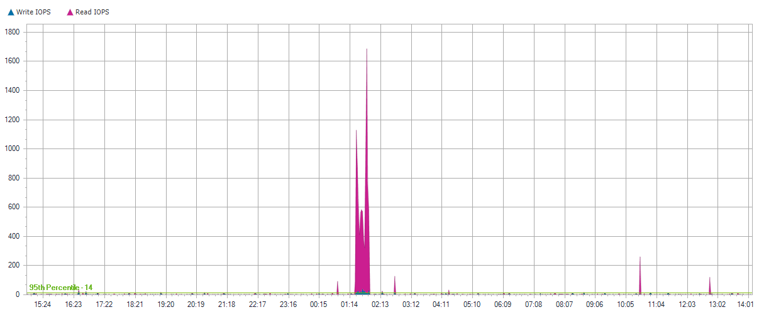
BAS-SERV

Slide 398
BAS-SERV

Slide 399
BAS-SERV

Slide 400
Local Disks for BAS-SERV

Slide 401
0 C: D:
Server Name | BAS-SERV
Server Operating System | Microsoft Windows 10 Pro
Total Local Capacity | 238.00 GB
Free Local Capacity | 181.00 GB (76%)
Used Local Capacity | 57.00 GB (24%)
Peak Throughput | 13.30 MB/s
Average Latency | 0.40 ms Reads and 0.55 ms Writes
IOPS | 14 at 95%
Read/Write Ratio | 93% / 7%
Average IO Size | Read: 13.49 KB / Write: 12.25 KB

Slide 402
0 C: D:

Slide 403
0 C: D:

Slide 404
0 C: D:

Slide 405
KCGFI-NEW

Slide 406
KCGFI-NEW
Operating System | Microsoft Windows XP Professional Service Pack 3
Time Recorded | 0 Hour(s), 0 Minute(s), 9/1/2020 - na
IOPS | 13 at 95%
Peak Disk Throughput | 17.10 MB/s
Read/Write Ratio | 29% / 71%
Total Local Capacity | 233.00 GB
Free Local Capacity | 198.00 GB (85%)
Used Local Capacity | 35.00 GB (15%)

Slide 407
KCGFI-NEW
Average IO Size | Read: 25.09 KB / Write: 12.36 KB
Average Latency | Read: 2.24 ms / Write: 0.25 ms
Average Queue Depth | 0
Peak/Min CPU | 7% / 0%
Peak/Min Memory | 1.62 GB / 1.67 GB
Peak/Min Memory In Use | 1.86 GB / 1.81 GB
CPU Sockets | 1
CPU Cores | 2
CPU Description | Intel Pentium III Xeon processor

Slide 408
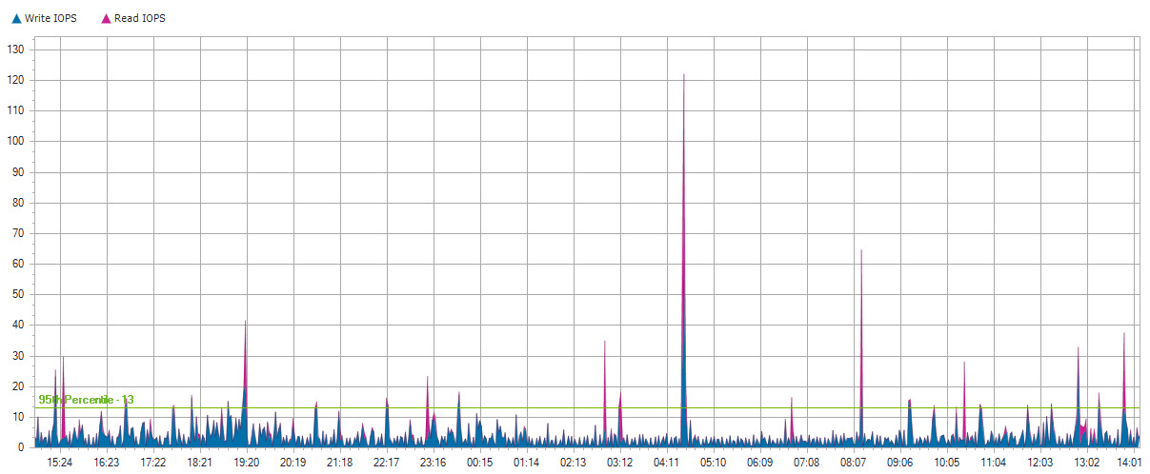
KCGFI-NEW

Slide 409
KCGFI-NEW

Slide 410
KCGFI-NEW

Slide 411
Local Disks for KCGFI-NEW

Slide 412
0 C: D: E: X:
Server Name | KCGFI-NEW
Server Operating System | Microsoft Windows XP Professional Service Pack 3
Total Local Capacity | 233.00 GB
Free Local Capacity | 198.00 GB (85%)
Used Local Capacity | 35.00 GB (15%)
Peak Throughput | 17.10 MB/s
Average Latency | 2.24 ms Reads and 0.25 ms Writes
IOPS | 13 at 95%
Read/Write Ratio | 29% / 71%
Average IO Size | Read: 25.09 KB / Write: 12.36 KB

Slide 413
0 C: D: E: X:

Slide 414
0 C: D: E: X:

Slide 415
0 C: D: E: X:

Slide 416
KCATA-UPDATE

Slide 417
KCATA-UPDATE
Operating System | Microsoft Windows Server 2012 R2 Standard
Time Recorded | 0 Hour(s), 0 Minute(s), 9/1/2020 - na
IOPS | 11 at 95%
Peak Disk Throughput | 3.30 MB/s
Read/Write Ratio | 86% / 14%
Total Local Capacity | 279.00 GB
Free Local Capacity | 220.00 GB (79%)
Used Local Capacity | 59.00 GB (21%)

Slide 418
KCATA-UPDATE
Average IO Size | Read: 59.61 KB / Write: 32.89 KB
Average Latency | Read: 3.20 ms / Write: 29.49 ms
Average Queue Depth | 0
Peak/Min CPU | 24% / 0%
Peak/Min Memory | 11.38 GB / 11.82 GB
Peak/Min Memory In Use | 4.62 GB / 4.17 GB
CPU Sockets | 1
CPU Cores | 4
CPU Description | Intel(R) Xeon(R) CPU E5310 @ 1.60GHz

Slide 419
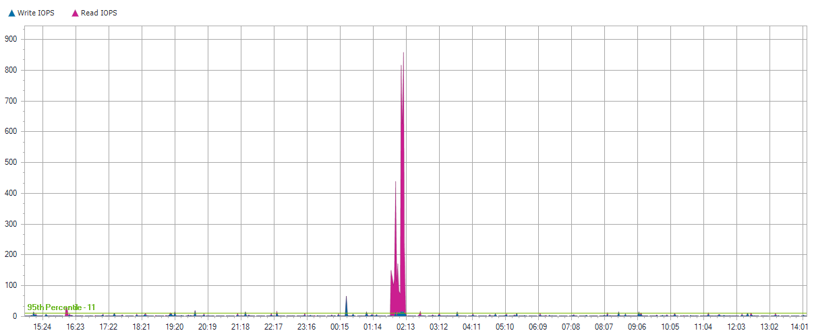
KCATA-UPDATE

Slide 420
KCATA-UPDATE

Slide 421
KCATA-UPDATE

Slide 422
Local Disks for KCATA-UPDATE

Slide 423
0 C:
Server Name | KCATA-UPDATE
Server Operating System | Microsoft Windows Server 2012 R2 Standard
Total Local Capacity | 279.00 GB
Free Local Capacity | 220.00 GB (79%)
Used Local Capacity | 59.00 GB (21%)
Peak Throughput | 3.30 MB/s
Average Latency | 3.20 ms Reads and 29.49 ms Writes
IOPS | 11 at 95%
Read/Write Ratio | 86% / 14%
Average IO Size | Read: 59.61 KB / Write: 32.89 KB

Slide 424
0 C:

Slide 425
0 C:

Slide 426
0 C:

Slide 427
KCHAST-PROC

Slide 428
KCHAST-PROC
Operating System | Microsoft Windows Server 2008 R2 Standard Service Pack 1
Time Recorded | 0 Hour(s), 0 Minute(s), 9/1/2020 - na
IOPS | 10 at 95%
Peak Disk Throughput | 42.00 MB/s
Read/Write Ratio | 94% / 6%
Total Local Capacity | 75.00 GB
Free Local Capacity | 19.00 GB (25%)
Used Local Capacity | 56.00 GB (75%)

Slide 429
KCHAST-PROC
Average IO Size | Read: 66.41 KB / Write: 34.82 KB
Average Latency | Read: 17.47 ms / Write: 0.13 ms
Average Queue Depth | 0
Peak/Min CPU | 22% / 0%
Peak/Min Memory | 3.27 GB / 4.09 GB
Peak/Min Memory In Use | 2.67 GB / 1.85 GB
CPU Sockets | 2
CPU Cores | 4
CPU Description | Intel(R) Xeon(R) CPU E5-2643 v4 @ 3.40GHz

Slide 430
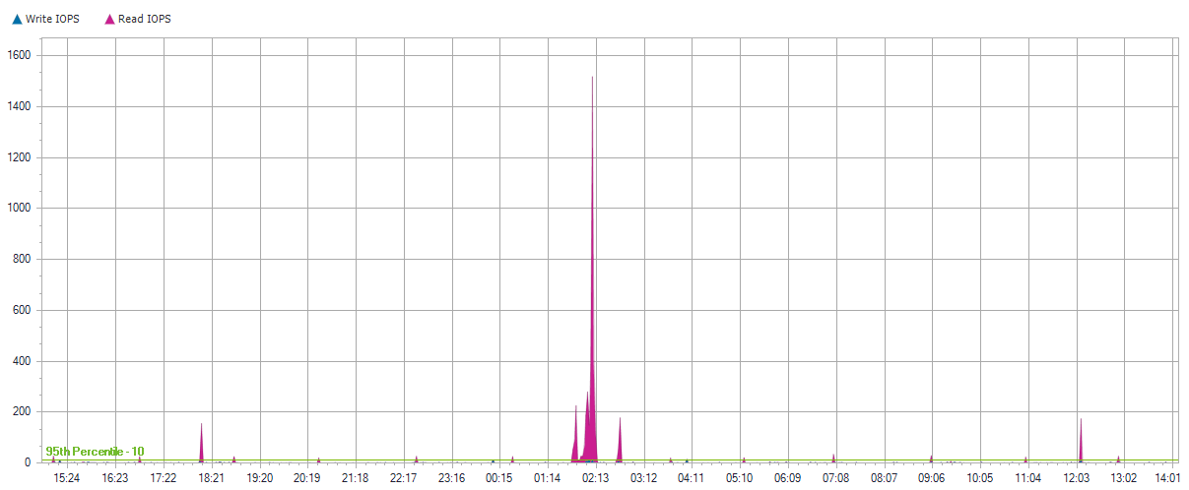
KCHAST-PROC

Slide 431
KCHAST-PROC

Slide 432
KCHAST-PROC

Slide 433
Local Disks for KCHAST-PROC

Slide 434
0 C:
Server Name | KCHAST-PROC
Server Operating System | Microsoft Windows Server 2008 R2 Standard Service Pack 1
Total Local Capacity | 75.00 GB
Free Local Capacity | 19.00 GB (25%)
Used Local Capacity | 56.00 GB (75%)
Peak Throughput | 42.00 MB/s
Average Latency | 17.47 ms Reads and 0.13 ms Writes
IOPS | 10 at 95%
Read/Write Ratio | 94% / 6%
Average IO Size | Read: 66.41 KB / Write: 34.82 KB

Slide 435
0 C:

Slide 436
0 C:

Slide 437
0 C:

Slide 438
TMAPP1-13

Slide 439
TMAPP1-13
Operating System | Microsoft Windows Server 2008 R2 Enterprise Service Pack 1
Time Recorded | 0 Hour(s), 0 Minute(s), 9/1/2020 - na
IOPS | 7 at 95%
Peak Disk Throughput | 0.10 MB/s
Read/Write Ratio | 1% / 99%
Total Local Capacity | 279.00 GB
Free Local Capacity | 191.00 GB (68%)
Used Local Capacity | 88.00 GB (32%)

Slide 440
TMAPP1-13
Average IO Size | Read: 10.08 KB / Write: 6.57 KB
Average Latency | Read: 0.45 ms / Write: 16.74 ms
Average Queue Depth | 0
Peak/Min CPU | 6% / 0%
Peak/Min Memory | 11.13 GB / 11.75 GB
Peak/Min Memory In Use | 4.86 GB / 4.24 GB
CPU Sockets | 2
CPU Cores | 8
CPU Description | Intel(R) Xeon(R) CPU E5620 @ 2.40GHz

Slide 441
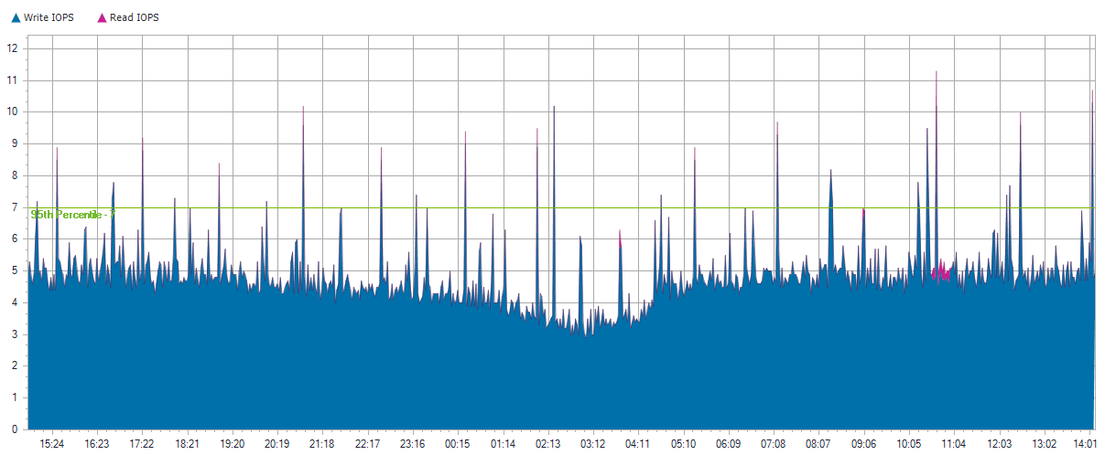
TMAPP1-13

Slide 442
TMAPP1-13

Slide 443
TMAPP1-13

Slide 444
Local Disks for TMAPP1-13

Slide 445
0 C:
Server Name | TMAPP1-13
Server Operating System | Microsoft Windows Server 2008 R2 Enterprise Service Pack 1
Total Local Capacity | 279.00 GB
Free Local Capacity | 191.00 GB (68%)
Used Local Capacity | 88.00 GB (32%)
Peak Throughput | 0.10 MB/s
Average Latency | 0.40 ms Reads and 17.13 ms Writes
IOPS | 6 at 95%
Read/Write Ratio | 1% / 99%
Average IO Size | Read: 9.62 KB / Write: 6.14 KB

Slide 446
0 C:

Slide 447
0 C:

Slide 448
0 C:

Slide 449
ad89fc7e93fd31208deeb7c9f2b778820000000000
Server Name | TMAPP1-13
Server Operating System | Microsoft Windows Server 2008 R2 Enterprise Service Pack 1
Total Local Capacity | 20.00 GB
Free Local Capacity | 18.00 GB (90%)
Used Local Capacity | 2.00 GB (10%)
Peak Throughput | 0.10 MB/s
Average Latency | 1.66 ms Reads and 9.15 ms Writes
IOPS | 0 at 95%
Read/Write Ratio | 10% / 90%
Average IO Size | Read: 23.40 KB / Write: 14.96 KB

Slide 450
ad89fc7e93fd31208deeb7c9f2b778820000000000

Slide 451
ad89fc7e93fd31208deeb7c9f2b778820000000000

Slide 452
ad89fc7e93fd31208deeb7c9f2b778820000000000

Slide 453
KCATAAPPS

Slide 454
KCATAAPPS
Operating System | Microsoft(R) Windows(R) Server 2003 Standard x64 Edition Service Pack 2
Time Recorded | 0 Hour(s), 0 Minute(s), 9/1/2020 - na
IOPS | 7 at 95%
Peak Disk Throughput | 18.20 MB/s
Read/Write Ratio | 90% / 10%
Total Local Capacity | 137.00 GB
Free Local Capacity | 96.00 GB (70%)
Used Local Capacity | 41.00 GB (30%)

Slide 455
KCATAAPPS
Average IO Size | Read: 2.57 KB / Write: 6.75 KB
Average Latency | Read: 0.20 ms / Write: 1.42 ms
Average Queue Depth | 0
Peak/Min CPU | 10% / 0%
Peak/Min Memory | 10.71 GB / 10.75 GB
Peak/Min Memory In Use | 13.28 GB / 13.24 GB
CPU Sockets | 4
CPU Cores | 4
CPU Description | Intel(R) Xeon(R) CPU E5310 @ 1.60GHz

Slide 456
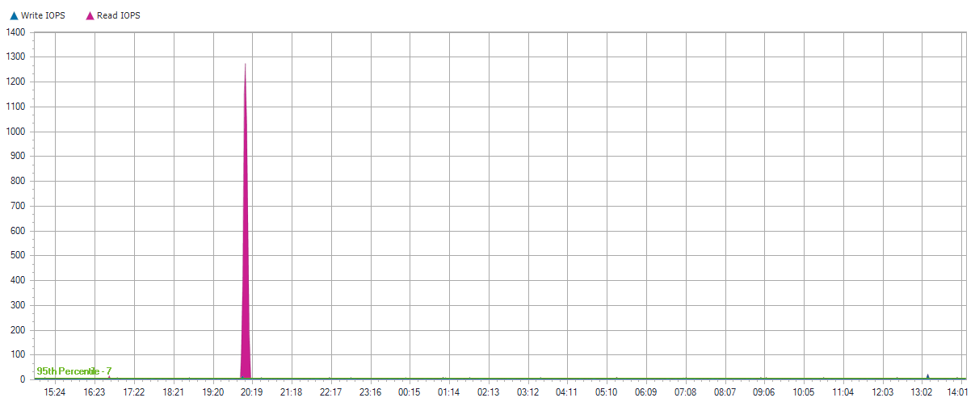
KCATAAPPS

Slide 457
KCATAAPPS

Slide 458
KCATAAPPS

Slide 459
Local Disks for KCATAAPPS

Slide 460
0 C: P:
Server Name | KCATAAPPS
Server Operating System | Microsoft(R) Windows(R) Server 2003 Standard x64 Edition Service Pack 2
Total Local Capacity | 137.00 GB
Free Local Capacity | 96.00 GB (70%)
Used Local Capacity | 41.00 GB (30%)
Peak Throughput | 18.20 MB/s
Average Latency | 0.20 ms Reads and 1.42 ms Writes
IOPS | 7 at 95%
Read/Write Ratio | 90% / 10%
Average IO Size | Read: 2.57 KB / Write: 6.75 KB

Slide 461
0 C: P:

Slide 462
0 C: P:

Slide 463
0 C: P:

Slide 464
KCHAST-FS

Slide 465
KCHAST-FS
Operating System | Microsoft Windows Server 2008 R2 Standard Service Pack 1
Time Recorded | 0 Hour(s), 0 Minute(s), 9/1/2020 - na
IOPS | 5 at 95%
Peak Disk Throughput | 1.20 MB/s
Read/Write Ratio | 10% / 90%
Total Local Capacity | 279.00 GB
Free Local Capacity | 79.00 GB (28%)
Used Local Capacity | 200.00 GB (72%)

Slide 466
KCHAST-FS
Average IO Size | Read: 39.57 KB / Write: 8.84 KB
Average Latency | Read: 49.63 ms / Write: 13.25 ms
Average Queue Depth | 0
Peak/Min CPU | 6% / 0%
Peak/Min Memory | 8.75 GB / 9.28 GB
Peak/Min Memory In Use | 3.24 GB / 2.71 GB
CPU Sockets | 1
CPU Cores | 6
CPU Description | Intel(R) Xeon(R) CPU X5675 @ 3.07GHz

Slide 467
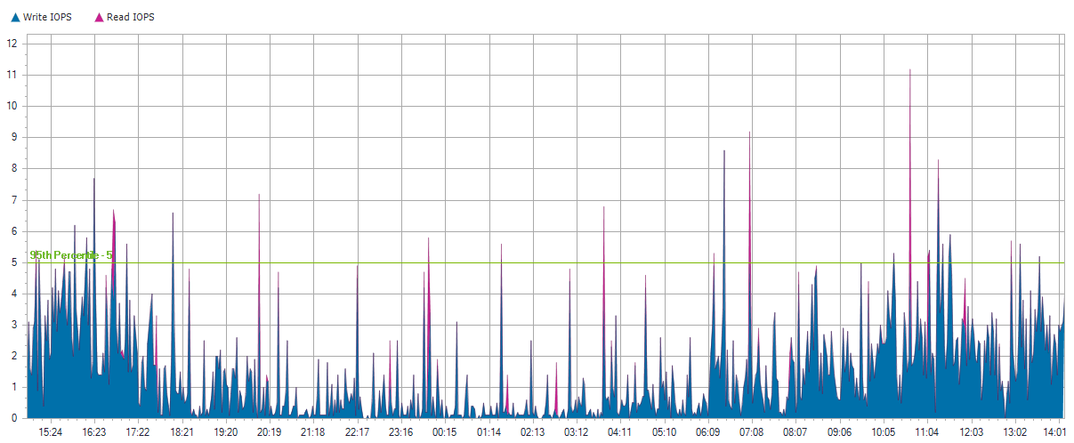
KCHAST-FS

Slide 468
KCHAST-FS

Slide 469
KCHAST-FS

Slide 470
Local Disks for KCHAST-FS

Slide 471
0 C:
Server Name | KCHAST-FS
Server Operating System | Microsoft Windows Server 2008 R2 Standard Service Pack 1
Total Local Capacity | 279.00 GB
Free Local Capacity | 79.00 GB (28%)
Used Local Capacity | 200.00 GB (72%)
Peak Throughput | 1.20 MB/s
Average Latency | 49.63 ms Reads and 13.25 ms Writes
IOPS | 5 at 95%
Read/Write Ratio | 10% / 90%
Average IO Size | Read: 39.57 KB / Write: 8.84 KB

Slide 472
0 C:

Slide 473
0 C:

Slide 474
0 C:

Slide 475
KCSQLP

Slide 476
KCSQLP
Operating System | Microsoft(R) Windows(R) Server 2003 Standard Edition Service Pack 2
Time Recorded | 0 Hour(s), 0 Minute(s), 9/1/2020 - na
IOPS | 5 at 95%
Peak Disk Throughput | 3.30 MB/s
Read/Write Ratio | 18% / 82%
Total Local Capacity | 192.00 GB
Free Local Capacity | 120.00 GB (63%)
Used Local Capacity | 72.00 GB (38%)

Slide 477
KCSQLP
Average IO Size | Read: 3.05 KB / Write: 9.28 KB
Average Latency | Read: 0.05 ms / Write: 1.14 ms
Average Queue Depth | 0
Peak/Min CPU | 25% / 0%
Peak/Min Memory | 1.55 GB / 1.59 GB
Peak/Min Memory In Use | 1.95 GB / 1.91 GB
CPU Sockets | 4
CPU Cores | 4
CPU Description | Intel(R) Xeon(TM) CPU 3.60GHz

Slide 478
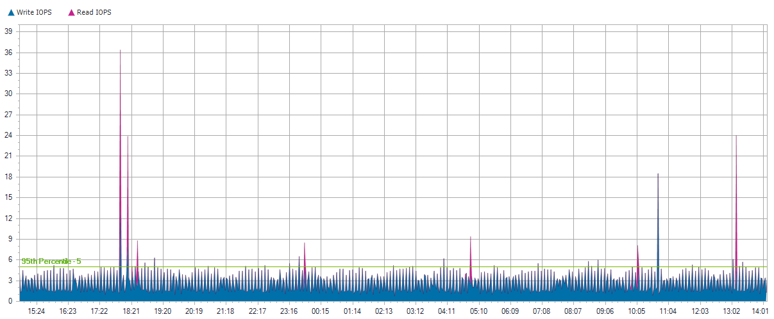
KCSQLP

Slide 479
KCSQLP

Slide 480
KCSQLP

Slide 481
Local Disks for KCSQLP

Slide 482
0 C:
Server Name | KCSQLP
Server Operating System | Microsoft(R) Windows(R) Server 2003 Standard Edition Service Pack 2
Total Local Capacity | 34.00 GB
Free Local Capacity | 24.00 GB (71%)
Used Local Capacity | 10.00 GB (29%)
Peak Throughput | 0.20 MB/s
Average Latency | 0.04 ms Reads and 1.15 ms Writes
IOPS | 5 at 95%
Read/Write Ratio | 11% / 89%
Average IO Size | Read: 0.41 KB / Write: 7.19 KB

Slide 483
0 C:

Slide 484
0 C:

Slide 485
0 C:

Slide 486
1 S:
Server Name | KCSQLP
Server Operating System | Microsoft(R) Windows(R) Server 2003 Standard Edition Service Pack 2
Total Local Capacity | 79.00 GB
Free Local Capacity | 48.00 GB (61%)
Used Local Capacity | 31.00 GB (39%)
Peak Throughput | 1.90 MB/s
Average Latency | 0.06 ms Reads and 0.71 ms Writes
IOPS | 0 at 95%
Read/Write Ratio | 44% / 56%
Average IO Size | Read: 8.64 KB / Write: 3.88 KB

Slide 487
1 S:

Slide 488
1 S:

Slide 489
1 S:

Slide 490
2 B:
Server Name | KCSQLP
Server Operating System | Microsoft(R) Windows(R) Server 2003 Standard Edition Service Pack 2
Total Local Capacity | 79.00 GB
Free Local Capacity | 48.00 GB (61%)
Used Local Capacity | 31.00 GB (39%)
Peak Throughput | 2.20 MB/s
Average Latency | 0.00 ms Reads and 0.03 ms Writes
IOPS | 0 at 95%
Read/Write Ratio | 73% / 27%
Average IO Size | Read: 0.79 KB / Write: 2.29 KB

Slide 491
2 B:

Slide 492
2 B:

Slide 493
2 B:

Slide 494
KCTSP-NEW

Slide 495
KCTSP-NEW
Operating System | Microsoft Windows Server 2016 Standard
Time Recorded | 0 Hour(s), 0 Minute(s), 9/1/2020 - na
IOPS | 4 at 95%
Peak Disk Throughput | 4.40 MB/s
Read/Write Ratio | 19% / 81%
Total Local Capacity | 1.82 TB
Free Local Capacity | 1.75 TB (96%)
Used Local Capacity | 76.00 GB (4%)

Slide 496
KCTSP-NEW
Average IO Size | Read: 26.51 KB / Write: 13.28 KB
Average Latency | Read: 0.72 ms / Write: 0.17 ms
Average Queue Depth | 0
Peak/Min CPU | 15% / 6%
Peak/Min Memory | 6.77 GB / 7.01 GB
Peak/Min Memory In Use | 8.89 GB / 8.65 GB
CPU Sockets | 1
CPU Cores | 4
CPU Description | Intel(R) Xeon(R) Silver 4112 CPU @ 2.60GHz

Slide 497
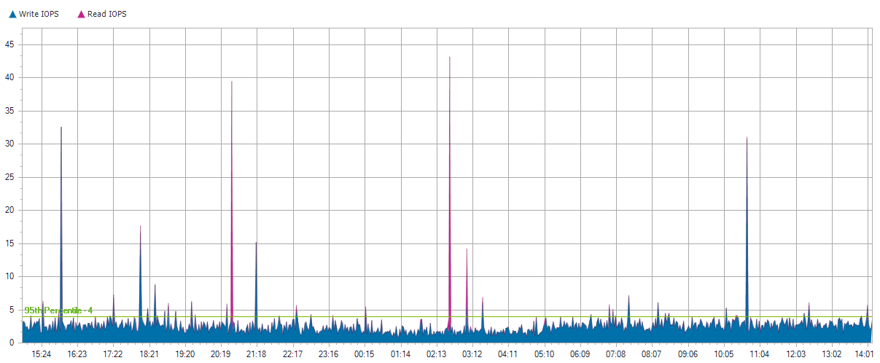
KCTSP-NEW

Slide 498
KCTSP-NEW

Slide 499
KCTSP-NEW

Slide 500
Local Disks for KCTSP-NEW

Slide 501
0 C:
Server Name | KCTSP-NEW
Server Operating System | Microsoft Windows Server 2016 Standard
Total Local Capacity | 1.82 TB
Free Local Capacity | 1.75 TB (96%)
Used Local Capacity | 76.00 GB (4%)
Peak Throughput | 4.40 MB/s
Average Latency | 0.72 ms Reads and 0.17 ms Writes
IOPS | 4 at 95%
Read/Write Ratio | 19% / 81%
Average IO Size | Read: 26.51 KB / Write: 13.28 KB

Slide 502
0 C:

Slide 503
0 C:

Slide 504
0 C:

Slide 505
TMPASS-COM

Slide 506
TMPASS-COM
Operating System | Microsoft Windows Server 2012 Standard
Time Recorded | 0 Hour(s), 0 Minute(s), 9/1/2020 - na
IOPS | 4 at 95%
Peak Disk Throughput | 12.60 MB/s
Read/Write Ratio | 38% / 62%
Total Local Capacity | 1.91 TB
Free Local Capacity | 1.77 TB (93%)
Used Local Capacity | 144.00 GB (7%)

Slide 507
TMPASS-COM
Average IO Size | Read: 123.92 KB / Write: 58.43 KB
Average Latency | Read: 20.04 ms / Write: 33.77 ms
Average Queue Depth | 0
Peak/Min CPU | 13% / 0%
Peak/Min Memory | 11.38 GB / 12.19 GB
Peak/Min Memory In Use | 8.62 GB / 7.81 GB
CPU Sockets | 1
CPU Cores | 4
CPU Description | Intel(R) Xeon(R) CPU E5440 @ 2.83GHz

Slide 508
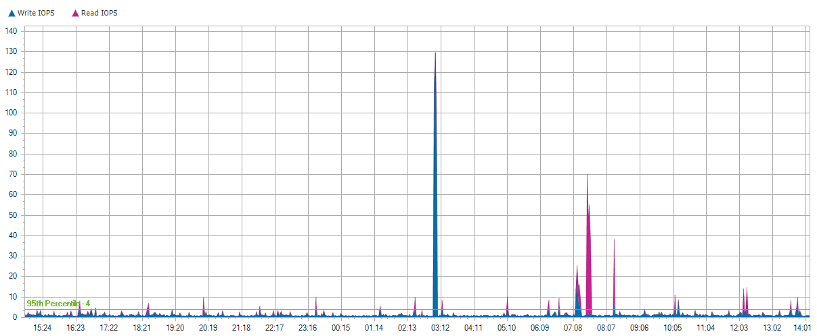
TMPASS-COM

Slide 509
TMPASS-COM

Slide 510
TMPASS-COM

Slide 511
Local Disks for TMPASS-COM

Slide 512
0 C:
Server Name | TMPASS-COM
Server Operating System | Microsoft Windows Server 2012 Standard
Total Local Capacity | 1.91 TB
Free Local Capacity | 1.77 TB (93%)
Used Local Capacity | 144.00 GB (7%)
Peak Throughput | 12.60 MB/s
Average Latency | 20.04 ms Reads and 33.77 ms Writes
IOPS | 4 at 95%
Read/Write Ratio | 38% / 62%
Average IO Size | Read: 123.92 KB / Write: 58.43 KB

Slide 513
0 C:

Slide 514
0 C:

Slide 515
0 C:

Slide 516
KC-LBI

Slide 517
KC-LBI
Operating System | Microsoft Windows Server 2008 R2 Standard
Time Recorded | 0 Hour(s), 0 Minute(s), 9/1/2020 - na
IOPS | 3 at 95%
Peak Disk Throughput | 8.70 MB/s
Read/Write Ratio | 5% / 95%
Total Local Capacity | 68.00 GB
Free Local Capacity | 2.00 GB (3%)
Used Local Capacity | 66.00 GB (97%)

Slide 518
KC-LBI
Average IO Size | Read: 97.26 KB / Write: 12.57 KB
Average Latency | Read: 31.22 ms / Write: 1.87 ms
Average Queue Depth | 0
Peak/Min CPU | 29% / 0%
Peak/Min Memory | 14.95 GB / 15.16 GB
Peak/Min Memory In Use | 3.05 GB / 2.83 GB
CPU Sockets | 1
CPU Cores | 2
CPU Description | Intel(R) Xeon(R) CPU E5205 @ 1.86GHz

Slide 519
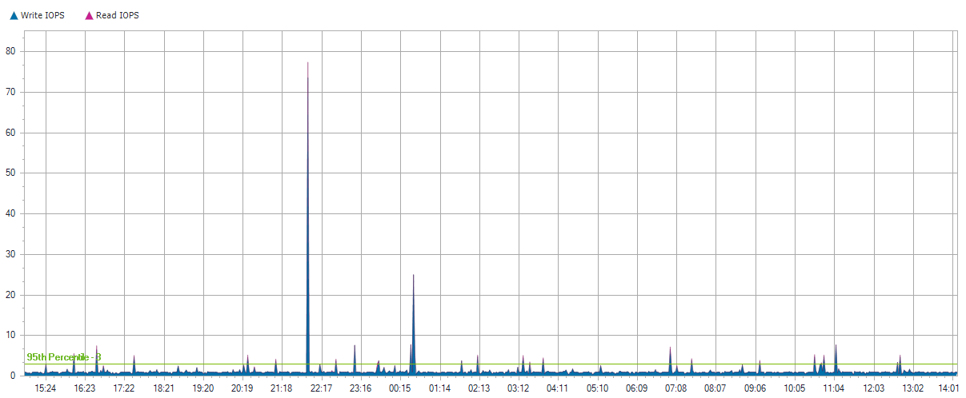
KC-LBI

Slide 520
KC-LBI

Slide 521
KC-LBI

Slide 522
Local Disks for KC-LBI

Slide 523
0 C:
Server Name | KC-LBI
Server Operating System | Microsoft Windows Server 2008 R2 Standard
Total Local Capacity | 68.00 GB
Free Local Capacity | 2.00 GB (3%)
Used Local Capacity | 66.00 GB (97%)
Peak Throughput | 8.70 MB/s
Average Latency | 31.22 ms Reads and 1.87 ms Writes
IOPS | 3 at 95%
Read/Write Ratio | 5% / 95%
Average IO Size | Read: 97.26 KB / Write: 12.57 KB

Slide 524
0 C:

Slide 525
0 C:

Slide 526
0 C:

Slide 527
KC-WEB

Slide 528
KC-WEB
Operating System | Microsoft Windows Server 2008 R2 Standard Service Pack 1
Time Recorded | 0 Hour(s), 0 Minute(s), 9/1/2020 - na
IOPS | 3 at 95%
Peak Disk Throughput | 0.10 MB/s
Read/Write Ratio | 1% / 99%
Total Local Capacity | 273.00 GB
Free Local Capacity | 57.00 GB (21%)
Used Local Capacity | 216.00 GB (79%)

Slide 529
KC-WEB
Average IO Size | Read: 3.45 KB / Write: 8.50 KB
Average Latency | Read: 1.17 ms / Write: 30.95 ms
Average Queue Depth | 0
Peak/Min CPU | 4% / 0%
Peak/Min Memory | 3.55 GB / 3.86 GB
Peak/Min Memory In Use | 4.44 GB / 4.13 GB
CPU Sockets | 2
CPU Cores | 8
CPU Description | Intel(R) Xeon(R) CPU E5520 @ 2.27GHz

Slide 530
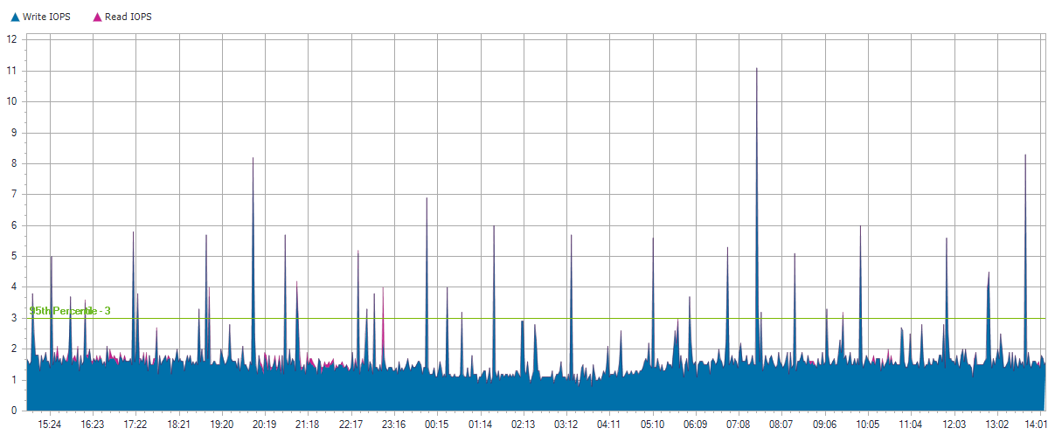
KC-WEB

Slide 531
KC-WEB

Slide 532
KC-WEB

Slide 533
Local Disks for KC-WEB

Slide 534
0 C:
Server Name | KC-WEB
Server Operating System | Microsoft Windows Server 2008 R2 Standard Service Pack 1
Total Local Capacity | 273.00 GB
Free Local Capacity | 57.00 GB (21%)
Used Local Capacity | 216.00 GB (79%)
Peak Throughput | 0.10 MB/s
Average Latency | 1.17 ms Reads and 30.95 ms Writes
IOPS | 3 at 95%
Read/Write Ratio | 1% / 99%
Average IO Size | Read: 3.45 KB / Write: 8.50 KB

Slide 535
0 C:

Slide 536
0 C:

Slide 537
0 C:

Slide 538
TMAPP2-13

Slide 539
TMAPP2-13
Operating System | Microsoft Windows Server 2008 R2 Enterprise Service Pack 1
Time Recorded | 0 Hour(s), 0 Minute(s), 9/1/2020 - na
IOPS | 2 at 95%
Peak Disk Throughput | 0.10 MB/s
Read/Write Ratio | 4% / 96%
Total Local Capacity | 279.00 GB
Free Local Capacity | 160.00 GB (57%)
Used Local Capacity | 119.00 GB (43%)

Slide 540
TMAPP2-13
Average IO Size | Read: 9.00 KB / Write: 5.83 KB
Average Latency | Read: 0.65 ms / Write: 14.46 ms
Average Queue Depth | 0
Peak/Min CPU | 4% / 0%
Peak/Min Memory | 27.89 GB / 28.18 GB
Peak/Min Memory In Use | 4.10 GB / 3.81 GB
CPU Sockets | 2
CPU Cores | 8
CPU Description | Intel(R) Xeon(R) CPU E5620 @ 2.40GHz

Slide 541
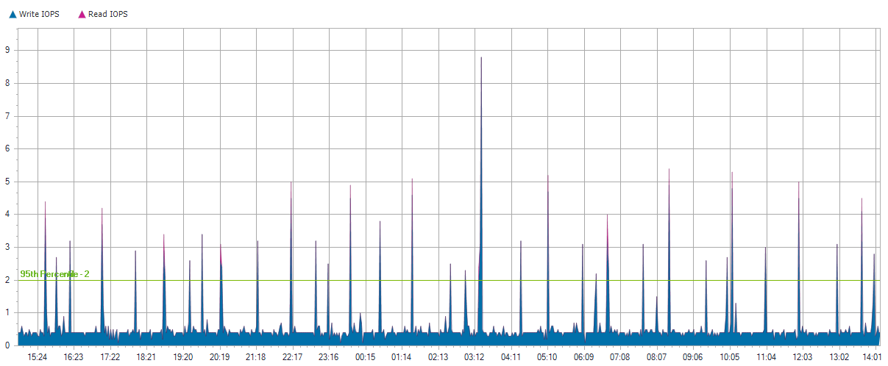
TMAPP2-13

Slide 542
TMAPP2-13

Slide 543
TMAPP2-13

Slide 544
Local Disks for TMAPP2-13

Slide 545
0 C:
Server Name | TMAPP2-13
Server Operating System | Microsoft Windows Server 2008 R2 Enterprise Service Pack 1
Total Local Capacity | 279.00 GB
Free Local Capacity | 160.00 GB (57%)
Used Local Capacity | 119.00 GB (43%)
Peak Throughput | 0.10 MB/s
Average Latency | 0.65 ms Reads and 14.46 ms Writes
IOPS | 2 at 95%
Read/Write Ratio | 4% / 96%
Average IO Size | Read: 9.00 KB / Write: 5.83 KB

Slide 546
0 C:

Slide 547
0 C:

Slide 548
0 C:

Slide 549
ad89fc7e93fd31208deeb7c9f2b778820000000000
Server Name | TMAPP2-13
Server Operating System | Microsoft Windows Server 2008 R2 Enterprise Service Pack 1
Total Local Capacity | 20.00 GB
Free Local Capacity | 18.00 GB (90%)
Used Local Capacity | 2.00 GB (10%)
Peak Throughput | 0.00 MB/s
Average Latency | 0.00 ms Reads and 0.00 ms Writes
IOPS | 0 at 95%
Read/Write Ratio | 0% / 100%
Average IO Size | Read: 0 KB / Write: 0 KB

Slide 550
ad89fc7e93fd31208deeb7c9f2b778820000000000

Slide 551
ad89fc7e93fd31208deeb7c9f2b778820000000000

Slide 552
ad89fc7e93fd31208deeb7c9f2b778820000000000

Slide 553
STORAGENODE-2

Slide 554
STORAGENODE-2
Operating System | Microsoft(R) Windows(R) Server 2003 Standard Edition Service Pack 2
Time Recorded | 0 Hour(s), 0 Minute(s), 9/1/2020 - na
IOPS | 2 at 95%
Peak Disk Throughput | 0.00 MB/s
Read/Write Ratio | 11% / 89%
Total Local Capacity | 626.00 GB
Free Local Capacity | 15.00 GB (2%)
Used Local Capacity | 611.00 GB (98%)

Slide 555
STORAGENODE-2
Average IO Size | Read: 0.18 KB / Write: 5.07 KB
Average Latency | Read: 0.02 ms / Write: 6.01 ms
Average Queue Depth | 0
Peak/Min CPU | 6% / 0%
Peak/Min Memory | 1.17 GB / 1.20 GB
Peak/Min Memory In Use | 849.13 MB / 820.15 MB
CPU Sockets | 4
CPU Cores | 4
CPU Description | Intel(R) Xeon(R) CPU E5345 @ 2.33GHz

Slide 556
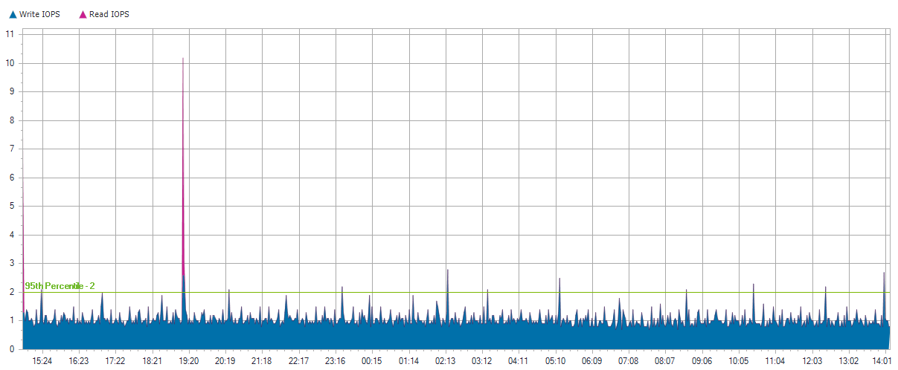
STORAGENODE-2

Slide 557
STORAGENODE-2

Slide 558
STORAGENODE-2

Slide 559
Local Disks for STORAGENODE-2

Slide 560
0 C:
Server Name | STORAGENODE-2
Server Operating System | Microsoft(R) Windows(R) Server 2003 Standard Edition Service Pack 2
Total Local Capacity | 30.00 GB
Free Local Capacity | 15.00 GB (50%)
Used Local Capacity | 15.00 GB (50%)
Peak Throughput | 0.00 MB/s
Average Latency | 0.02 ms Reads and 6.01 ms Writes
IOPS | 2 at 95%
Read/Write Ratio | 11% / 89%
Average IO Size | Read: 0.18 KB / Write: 5.07 KB

Slide 561
0 C:

Slide 562
0 C:

Slide 563
0 C:

Slide 564
PBACB0A9VVQ1J9-b3b1330e
Server Name | STORAGENODE-2
Server Operating System | Microsoft(R) Windows(R) Server 2003 Standard Edition Service Pack 2
Total Local Capacity | 5.00 GB
Free Local Capacity | 0 GB (0%)
Used Local Capacity | 5.00 GB (100%)
Peak Throughput | 0.00 MB/s
Average Latency | 0.00 ms Reads and 0.00 ms Writes
IOPS | 0 at 95%
Read/Write Ratio | 0% / 100%
Average IO Size | Read: 0 KB / Write: 0 KB

Slide 565
PBACB0A9VVQ1J9-b3b1330e

Slide 566
PBACB0A9VVQ1J9-b3b1330e

Slide 567
PBACB0A9VVQ1J9-b3b1330e

Slide 568
2
Server Name | STORAGENODE-2
Server Operating System | Microsoft(R) Windows(R) Server 2003 Standard Edition Service Pack 2
Total Local Capacity | 44.00 GB
Free Local Capacity | 0 GB (0%)
Used Local Capacity | 44.00 GB (100%)
Peak Throughput | 0.00 MB/s
Average Latency | 0.00 ms Reads and 0.00 ms Writes
IOPS | 0 at 95%
Read/Write Ratio | 0% / 100%
Average IO Size | Read: 0 KB / Write: 0 KB

Slide 569
2

Slide 570
2

Slide 571
2

Slide 572
P61630G9SVO2RX-2003fbea
Server Name | STORAGENODE-2
Server Operating System | Microsoft(R) Windows(R) Server 2003 Standard Edition Service Pack 2
Total Local Capacity | 547.00 GB
Free Local Capacity | 0 GB (0%)
Used Local Capacity | 547.00 GB (100%)
Peak Throughput | 0.00 MB/s
Average Latency | 0.00 ms Reads and 0.00 ms Writes
IOPS | 0 at 95%
Read/Write Ratio | 0% / 100%
Average IO Size | Read: 0 KB / Write: 0 KB

Slide 573
P61630G9SVO2RX-2003fbea

Slide 574
P61630G9SVO2RX-2003fbea

Slide 575
P61630G9SVO2RX-2003fbea

Slide 576
Individual Shared Cluster Disk Reports

Slide 577
ad89fc7e93fd31208deeb7c9f2b778820000000000
Total Capacity | 400.00 GB
Free Capacity | 0 GB (0%)
Used Capacity | 400.00 GB (100%)
Peak Throughput | 45.40 MB/s
Average Latency | 17.57 ms Reads and 16.90 ms Writes
IOPS | 37 at 95%
Read/Write Ratio | 50% / 50%
Average IO Size | Read: 211.01 KB / Write: 91.13 KB

Slide 578
ad89fc7e93fd31208deeb7c9f2b778820000000000

Slide 579
ad89fc7e93fd31208deeb7c9f2b778820000000000

Slide 580
ad89fc7e93fd31208deeb7c9f2b778820000000000

Slide 581
ad89fc7e93fd31208deeb7c9f2b778820000000000
Total Capacity | 25.00 GB
Free Capacity | 0 GB (0%)
Used Capacity | 25.00 GB (100%)
Peak Throughput | 0.00 MB/s
Average Latency | 0.37 ms Reads and 4.33 ms Writes
IOPS | 1 at 95%
Read/Write Ratio | 2% / 98%
Average IO Size | Read: 0.09 KB / Write: 5.07 KB

Slide 582
ad89fc7e93fd31208deeb7c9f2b778820000000000

Slide 583
ad89fc7e93fd31208deeb7c9f2b778820000000000

Slide 584
ad89fc7e93fd31208deeb7c9f2b778820000000000

Slide 585
ad89fc7e93fd31208deeb7c9f2b778820000000000
Total Capacity | 20.00 GB
Free Capacity | 18.00 GB (90%)
Used Capacity | 2.00 GB (10%)
Peak Throughput | 0.10 MB/s
Average Latency | 1.66 ms Reads and 9.15 ms Writes
IOPS | 0 at 95%
Read/Write Ratio | 10% / 90%
Average IO Size | Read: 23.40 KB / Write: 14.96 KB

Slide 586
ad89fc7e93fd31208deeb7c9f2b778820000000000

Slide 587
ad89fc7e93fd31208deeb7c9f2b778820000000000

Slide 588
ad89fc7e93fd31208deeb7c9f2b778820000000000

Slide 589
ad89fc7e93fd31208deeb7c9f2b778820000000000
Total Capacity | 30.00 GB
Free Capacity | 0 GB (0%)
Used Capacity | 30.00 GB (100%)
Peak Throughput | 0.00 MB/s
Average Latency | 0.28 ms Reads and 0.00 ms Writes
IOPS | 0 at 95%
Read/Write Ratio | 100% / 0%
Average IO Size | Read: 0.12 KB / Write: 0 KB

Slide 590
ad89fc7e93fd31208deeb7c9f2b778820000000000

Slide 591
ad89fc7e93fd31208deeb7c9f2b778820000000000

Slide 592
ad89fc7e93fd31208deeb7c9f2b778820000000000

Slide 593
ad89fc7e93fd31208deeb7c9f2b778820000000000
Total Capacity | 25.00 GB
Free Capacity | 0 GB (0%)
Used Capacity | 25.00 GB (100%)
Peak Throughput | 0.00 MB/s
Average Latency | 0.09 ms Reads and 0.00 ms Writes
IOPS | 0 at 95%
Read/Write Ratio | 100% / 0%
Average IO Size | Read: 0.02 KB / Write: 0 KB

Slide 594
ad89fc7e93fd31208deeb7c9f2b778820000000000

Slide 595
ad89fc7e93fd31208deeb7c9f2b778820000000000

Slide 596
ad89fc7e93fd31208deeb7c9f2b778820000000000

Slide 597
Summaries

Slide 598
Servers Recorded
Server Name | Total Capacity | Free Capacity | Used Capacity | IOPS | Peak Disk Throughput | Read/Write Ratio | Peak Network
KC-APOLLO | 12.74 TB | 2.72 TB | 10.01 TB | 199 at 95% | 11.40 MB/s | 21% / 79% | 8.93 MB/s
KCHAST-APPS | 279.00 GB | 147.00 GB | 132.00 GB | 35 at 95% | 12.80 MB/s | 76% / 24% | 3.32 MB/s
KCATA-FS | 1.82 TB | 101.00 GB | 1.73 TB | 199 at 95% | 10.40 MB/s | 94% / 6% | 514.60 KB/s
KCATA-FW | 279.00 GB | 173.00 GB | 106.00 GB | 66 at 95% | 24.00 MB/s | 82% / 18% | 25.24 MB/s
KCATA-UPDATE | 279.00 GB | 220.00 GB | 59.00 GB | 11 at 95% | 3.30 MB/s | 86% / 14% | 111.90 KB/s
KC-EXCHANGE | 447.00 GB | 60.00 GB | 387.00 GB | 36 at 95% | 21.70 MB/s | 96% / 4% | 160.20 KB/s
KCHAST-FS | 279.00 GB | 79.00 GB | 200.00 GB | 5 at 95% | 1.20 MB/s | 10% / 90% | 0 KB/s
KCSQLH | 838.00 GB | 92.00 GB | 746.00 GB | 511 at 95% | 224.60 MB/s | 92% / 8% | 33.69 MB/s
KCSQLP2 | 279.00 GB | 99.00 GB | 180.00 GB | 45 at 95% | 61.00 MB/s | 91% / 9% | 8.30 MB/s
KC-TMRD | 279.00 GB | 32.00 GB | 247.00 GB | 36 at 95% | 10.10 MB/s | 90% / 10% | 411.40 KB/s

Slide 599
Servers Recorded
Server Name | Total Capacity | Free Capacity | Used Capacity | IOPS | Peak Disk Throughput | Read/Write Ratio | Peak Network
KC-TSRV | 279.00 GB | 124.00 GB | 155.00 GB | 41 at 95% | 9.80 MB/s | 92% / 8% | 129.00 KB/s
NET2-SAN | 1.20 TB | 12.00 GB | 1.19 TB | 171 at 95% | 8.70 MB/s | 94% / 6% | 27.31 MB/s
TMAPP1-13 | 279.00 GB | 191.00 GB | 88.00 GB | 7 at 95% | 0.10 MB/s | 1% / 99% | 0 KB/s
TMAPP2-13 | 279.00 GB | 160.00 GB | 119.00 GB | 2 at 95% | 0.10 MB/s | 4% / 96% | 0 KB/s
TMDB1-13 | 279.00 GB | 142.00 GB | 137.00 GB | 65 at 95% | 45.50 MB/s | 80% / 20% | 0 KB/s
TMDB2-13 | 279.00 GB | 161.00 GB | 118.00 GB | 37 at 95% | 13.50 MB/s | 76% / 24% | 0 KB/s
TMDC-13 | 279.00 GB | 96.00 GB | 183.00 GB | 245 at 95% | 21.00 MB/s | 84% / 16% | 44.10 KB/s
TMDC3 | 68.00 GB | 50.00 GB | 18.00 GB | 58 at 95% | 9.00 MB/s | 83% / 17% | 10.17 MB/s
TMINFO-13 | 1.44 TB | 537.00 GB | 942.00 GB | 259 at 95% | 54.30 MB/s | 73% / 27% | 0 KB/s
KCHAST-PROC | 75.00 GB | 19.00 GB | 56.00 GB | 10 at 95% | 42.00 MB/s | 94% / 6% | 583.50 KB/s

Slide 600
Servers Recorded
Server Name | Total Capacity | Free Capacity | Used Capacity | IOPS | Peak Disk Throughput | Read/Write Ratio | Peak Network
KCNAV | 232.00 GB | 59.00 GB | 173.00 GB | 51 at 95% | 47.60 MB/s | 53% / 47% | unknown/s
KCORA | 132.00 GB | 22.00 GB | 110.00 GB | 473 at 95% | 143.60 MB/s | 90% / 10% | unknown/s
KCSQLP | 192.00 GB | 120.00 GB | 72.00 GB | 5 at 95% | 3.30 MB/s | 18% / 82% | unknown/s
KCATAAPPS | 137.00 GB | 96.00 GB | 41.00 GB | 7 at 95% | 18.20 MB/s | 90% / 10% | unknown/s
KCATA-PS2 | 68.00 GB | 6.00 GB | 62.00 GB | 78 at 95% | 11.20 MB/s | 84% / 16% | 149.90 KB/s
KC-GFI | 332.00 GB | 152.00 GB | 180.00 GB | 256 at 95% | 100.10 MB/s | 91% / 9% | 46.91 MB/s
KCSQLP-NEW | 625.00 GB | 249.00 GB | 376.00 GB | 27 at 95% | 12.30 MB/s | 81% / 19% | 16.56 MB/s
KCTSP-NEW | 1.82 TB | 1.75 TB | 76.00 GB | 4 at 95% | 4.40 MB/s | 19% / 81% | 89.00 KB/s
STORAGENODE-1 | 680.00 GB | 17.00 GB | 663.00 GB | 23 at 95% | 3.70 MB/s | 90% / 10% | unknown/s
STORAGENODE-2 | 626.00 GB | 15.00 GB | 611.00 GB | 2 at 95% | 0.00 MB/s | 11% / 89% | unknown/s

Slide 601
Servers Recorded
Server Name | Total Capacity | Free Capacity | Used Capacity | IOPS | Peak Disk Throughput | Read/Write Ratio | Peak Network
KCATADASHBOARD | 1.37 TB | 122.00 GB | 1.25 TB | 51 at 95% | 44.10 MB/s | 88% / 12% | 89.11 MB/s
BAS-SERV | 238.00 GB | 181.00 GB | 57.00 GB | 14 at 95% | 13.30 MB/s | 93% / 7% | 147.70 KB/s
KCGFI-NEW | 233.00 GB | 198.00 GB | 35.00 GB | 13 at 95% | 17.10 MB/s | 29% / 71% | unknown/s
TMPASS-COM | 1.91 TB | 1.77 TB | 144.00 GB | 4 at 95% | 12.60 MB/s | 38% / 62% | 8.79 MB/s
KC-LBI | 68.00 GB | 2.00 GB | 66.00 GB | 3 at 95% | 8.70 MB/s | 5% / 95% | unknown/s
KC-WEB | 273.00 GB | 57.00 GB | 216.00 GB | 3 at 95% | 0.10 MB/s | 1% / 99% | 131.20 KB/s
KCSQLMHC | 273.00 GB | 134.00 GB | 139.00 GB | 26 at 95% | 6.50 MB/s | 91% / 9% | 1015.30 KB/s
KC-PROBE | 75.00 GB | 8.00 GB | 67.00 GB | 73 at 95% | 12.10 MB/s | 96% / 4% | 214.80 KB/s

Slide 602
Local Disks Recorded
Server Name | Disk Name | Total Capacity | Free Capacity | Used Capacity | IOPS | Peak Disk Throughput | Read/Write Ratio
KC-APOLLO | 0 C: | 12.74 TB | 2.72 TB | 10.01 TB | 199 at 95% | 11.40 MB/s | 21% / 79%
KCHAST-APPS | 0 C: | 279.00 GB | 147.00 GB | 132.00 GB | 35 at 95% | 12.80 MB/s | 76% / 24%
KCATA-FS | 0 C: | 137.00 GB | 25.00 GB | 112.00 GB | 11 at 95% | 8.20 MB/s | 70% / 30%
KCATA-FS | 1 H: H: | 547.00 GB | 24.00 GB | 523.00 GB | 26 at 95% | 3.80 MB/s | 94% / 6%
KCATA-FS | 2 H: H: | 1.16 TB | 52.00 GB | 1.11 TB | 168 at 95% | 7.80 MB/s | 97% / 3%
KCATA-FW | 0 C: | 279.00 GB | 173.00 GB | 106.00 GB | 66 at 95% | 24.00 MB/s | 82% / 18%
KCATA-UPDATE | 0 C: | 279.00 GB | 220.00 GB | 59.00 GB | 11 at 95% | 3.30 MB/s | 86% / 14%
KC-EXCHANGE | 0 C: D: | 447.00 GB | 60.00 GB | 387.00 GB | 36 at 95% | 21.70 MB/s | 96% / 4%
KCHAST-FS | 0 C: | 279.00 GB | 79.00 GB | 200.00 GB | 5 at 95% | 1.20 MB/s | 10% / 90%
KCSQLH | 0 C: | 838.00 GB | 92.00 GB | 746.00 GB | 511 at 95% | 224.60 MB/s | 92% / 8%

Slide 603
Local Disks Recorded
Server Name | Disk Name | Total Capacity | Free Capacity | Used Capacity | IOPS | Peak Disk Throughput | Read/Write Ratio
KCSQLP2 | 0 C: | 279.00 GB | 99.00 GB | 180.00 GB | 45 at 95% | 61.00 MB/s | 91% / 9%
KC-TMRD | 0 C: | 279.00 GB | 32.00 GB | 247.00 GB | 36 at 95% | 10.10 MB/s | 90% / 10%
KC-TSRV | 0 C: | 279.00 GB | 124.00 GB | 155.00 GB | 41 at 95% | 9.80 MB/s | 92% / 8%
NET2-SAN | 0 E: | 75.00 GB | 0 GB | 75.00 GB | 8 at 95% | 2.20 MB/s | 86% / 14%
NET2-SAN | 1 E: | 575.00 GB | 0 GB | 575.00 GB | 78 at 95% | 2.90 MB/s | 98% / 2%
NET2-SAN | 2 E: | 175.00 GB | 0 GB | 175.00 GB | 4 at 95% | 2.00 MB/s | 96% / 4%
NET2-SAN | 3 E: | 200.00 GB | 0 GB | 200.00 GB | 7 at 95% | 1.50 MB/s | 90% / 10%
NET2-SAN | 4 E: | 67.00 GB | 0 GB | 67.00 GB | 15 at 95% | 3.40 MB/s | 70% / 30%
NET2-SAN | 5 C: | 40.00 GB | 12.00 GB | 28.00 GB | 4 at 95% | 2.60 MB/s | 41% / 59%
NET2-SAN | 6 | 5.00 GB | 0 GB | 5.00 GB | 0 at 95% | 0.00 MB/s | 100% / 0%

Slide 604
Local Disks Recorded
Server Name | Disk Name | Total Capacity | Free Capacity | Used Capacity | IOPS | Peak Disk Throughput | Read/Write Ratio
NET2-SAN | 7 E: | 92.00 GB | 0 GB | 92.00 GB | 38 at 95% | 3.50 MB/s | 79% / 21%
TMAPP1-13 | 0 C: | 279.00 GB | 191.00 GB | 88.00 GB | 6 at 95% | 0.10 MB/s | 1% / 99%
TMAPP2-13 | 0 C: | 279.00 GB | 160.00 GB | 119.00 GB | 2 at 95% | 0.10 MB/s | 4% / 96%
TMDB1-13 | 0 C: | 279.00 GB | 142.00 GB | 137.00 GB | 22 at 95% | 4.80 MB/s | 90% / 10%
TMDB2-13 | 0 C: | 279.00 GB | 161.00 GB | 118.00 GB | 37 at 95% | 13.50 MB/s | 76% / 24%
TMDC-13 | 0 C: | 279.00 GB | 96.00 GB | 183.00 GB | 245 at 95% | 21.00 MB/s | 84% / 16%
TMDC3 | 0 C: | 68.00 GB | 50.00 GB | 18.00 GB | 58 at 95% | 9.00 MB/s | 83% / 17%
TMINFO-13 | 0 C: | 279.00 GB | 179.00 GB | 100.00 GB | 29 at 95% | 11.70 MB/s | 82% / 18%
TMINFO-13 | 1 D: | 1.17 TB | 358.00 GB | 842.00 GB | 224 at 95% | 52.60 MB/s | 74% / 26%
KCHAST-PROC | 0 C: | 75.00 GB | 19.00 GB | 56.00 GB | 10 at 95% | 42.00 MB/s | 94% / 6%

Slide 605
Local Disks Recorded
Server Name | Disk Name | Total Capacity | Free Capacity | Used Capacity | IOPS | Peak Disk Throughput | Read/Write Ratio
KCNAV | 0 C: | 34.00 GB | 1.00 GB | 33.00 GB | 2 at 95% | 4.10 MB/s | 85% / 15%
KCNAV | PB9840TX3UZ074-45054293 | 99.00 GB | 4.00 GB | 95.00 GB | 30 at 95% | 23.80 MB/s | 6% / 94%
KCNAV | PB9840TX3UZ074-4505428c | 99.00 GB | 54.00 GB | 45.00 GB | 19 at 95% | 23.80 MB/s | 100% / 0%
KCORA | 0 C: | 34.00 GB | 3.00 GB | 31.00 GB | 4 at 95% | 37.00 MB/s | 64% / 36%
KCORA | 1 D: | 68.00 GB | 8.00 GB | 60.00 GB | 466 at 95% | 143.40 MB/s | 93% / 7%
KCORA | 2 N: | 30.00 GB | 11.00 GB | 19.00 GB | 0 at 95% | 0.00 MB/s | 0% / 100%
KCSQLP | 0 C: | 34.00 GB | 24.00 GB | 10.00 GB | 5 at 95% | 0.20 MB/s | 11% / 89%
KCSQLP | 1 S: | 79.00 GB | 48.00 GB | 31.00 GB | 0 at 95% | 1.90 MB/s | 44% / 56%
KCSQLP | 2 B: | 79.00 GB | 48.00 GB | 31.00 GB | 0 at 95% | 2.20 MB/s | 73% / 27%
KCATAAPPS | 0 C: P: | 137.00 GB | 96.00 GB | 41.00 GB | 7 at 95% | 18.20 MB/s | 90% / 10%

Slide 606
Local Disks Recorded
Server Name | Disk Name | Total Capacity | Free Capacity | Used Capacity | IOPS | Peak Disk Throughput | Read/Write Ratio
KCATA-PS2 | 0 C: | 68.00 GB | 6.00 GB | 62.00 GB | 78 at 95% | 11.20 MB/s | 84% / 16%
KC-GFI | 0 C: | 137.00 GB | 37.00 GB | 100.00 GB | 122 at 95% | 78.80 MB/s | 88% / 12%
KC-GFI | 1 D: | 195.00 GB | 115.00 GB | 80.00 GB | 0 at 95% | 50.00 MB/s | 99% / 1%
KCSQLP-NEW | 0 C: | 137.00 GB | 15.00 GB | 122.00 GB | 26 at 95% | 6.40 MB/s | 82% / 18%
KCSQLP-NEW | A294FF2EFD5E4133A8B6C610A884F8E8-6e99c853 | 488.00 GB | 234.00 GB | 254.00 GB | 1 at 95% | 12.30 MB/s | 69% / 31%
KCTSP-NEW | 0 C: | 1.82 TB | 1.75 TB | 76.00 GB | 4 at 95% | 4.40 MB/s | 19% / 81%
STORAGENODE-1 | 0 C: | 30.00 GB | 17.00 GB | 13.00 GB | 2 at 95% | 0.00 MB/s | 11% / 89%
STORAGENODE-1 | 1 | 103.00 GB | 0 GB | 103.00 GB | 0 at 95% | 0.00 MB/s | 0% / 100%
STORAGENODE-1 | 2 D: | 547.00 GB | 0 GB | 547.00 GB | 21 at 95% | 3.70 MB/s | 91% / 9%
STORAGENODE-2 | 0 C: | 30.00 GB | 15.00 GB | 15.00 GB | 2 at 95% | 0.00 MB/s | 11% / 89%

Slide 607
Local Disks Recorded
Server Name | Disk Name | Total Capacity | Free Capacity | Used Capacity | IOPS | Peak Disk Throughput | Read/Write Ratio
STORAGENODE-2 | PBACB0A9VVQ1J9-b3b1330e | 5.00 GB | 0 GB | 5.00 GB | 0 at 95% | 0.00 MB/s | 0% / 100%
STORAGENODE-2 | 2 | 44.00 GB | 0 GB | 44.00 GB | 0 at 95% | 0.00 MB/s | 0% / 100%
STORAGENODE-2 | P61630G9SVO2RX-2003fbea | 547.00 GB | 0 GB | 547.00 GB | 0 at 95% | 0.00 MB/s | 0% / 100%
KCATADASHBOARD | 0 C: D: | 466.00 GB | 33.00 GB | 433.00 GB | 48 at 95% | 31.10 MB/s | 90% / 10%
KCATADASHBOARD | 1 E: F: H: | 932.00 GB | 89.00 GB | 843.00 GB | 0 at 95% | 44.00 MB/s | 1% / 99%
BAS-SERV | 0 C: D: | 238.00 GB | 181.00 GB | 57.00 GB | 14 at 95% | 13.30 MB/s | 93% / 7%
KCGFI-NEW | 0 C: D: E: X: | 233.00 GB | 198.00 GB | 35.00 GB | 13 at 95% | 17.10 MB/s | 29% / 71%
TMPASS-COM | 0 C: | 1.91 TB | 1.77 TB | 144.00 GB | 4 at 95% | 12.60 MB/s | 38% / 62%
KC-LBI | 0 C: | 68.00 GB | 2.00 GB | 66.00 GB | 3 at 95% | 8.70 MB/s | 5% / 95%
KC-WEB | 0 C: | 273.00 GB | 57.00 GB | 216.00 GB | 3 at 95% | 0.10 MB/s | 1% / 99%

Slide 608
Local Disks Recorded
Server Name | Disk Name | Total Capacity | Free Capacity | Used Capacity | IOPS | Peak Disk Throughput | Read/Write Ratio
KCSQLMHC | 0 C: | 273.00 GB | 134.00 GB | 139.00 GB | 26 at 95% | 6.50 MB/s | 91% / 9%
KC-PROBE | 0 C: D: | 75.00 GB | 8.00 GB | 67.00 GB | 73 at 95% | 12.10 MB/s | 96% / 4%

Slide 609
Shared Cluster Disks Recorded
Cluster Disk Name | Total Capacity | Free Capacity | Used Capacity | IOPS | Peak Disk Throughput | Read/Write Ratio
ad89fc7e93fd31208deeb7c9f2b778820000000000 | 20.00 GB | 18.00 GB | 2.00 GB | 0 at 95% | 0.10 MB/s | 10% / 90%
ad89fc7e93fd31208deeb7c9f2b778820000000000 | 25.00 GB | 0 GB | 25.00 GB | 1 at 95% | 0.00 MB/s | 2% / 98%
ad89fc7e93fd31208deeb7c9f2b778820000000000 | 30.00 GB | 0 GB | 30.00 GB | 0 at 95% | 0.00 MB/s | 100% / 0%
ad89fc7e93fd31208deeb7c9f2b778820000000000 | 25.00 GB | 0 GB | 25.00 GB | 0 at 95% | 0.00 MB/s | 100% / 0%
ad89fc7e93fd31208deeb7c9f2b778820000000000 | 400.00 GB | 0 GB | 400.00 GB | 37 at 95% | 45.40 MB/s | 50% / 50%

Slide 610
Definitions
CPU
The CPU shown in the individual server reports measures the utilization of the CPU as a percentage of the total available CPU clock cycles. When shown in the aggregate summary, the CPU aggregate represents the sum of the clock cycles utilized. The saturated core count shows the number of CPU cores that were observed to have a usage level of 90% or more during the sampling period. This count provides insight into how your CPU workloads are distributed across all the cores. If a core is saturated, the task that it is processing is bottlenecked on the CPU. By spreading tasks out over multiple threads (and thus multiple cores) the bottleneck may be removed. Live Optics supports saturated core counts for Windows and Linux hosts. Saturated core counts for other host operating systems are not supported.
IOPS
Live Optics monitors the read and write operations at the block storage layer of the host operating system. IOPS are the Input / Output Operations per Second performed by a physical server host or a virtual machine.

Slide 611
Definitions
IO Transfer Size
This unit of measure records the average payload size of a given set of read or write operations. The average IO transfer size may be used to describe the nature of the IO workload and is an important factor in understanding the character of an IO workload.
Latency
The average time required for the host to complete an IO operation is measured as its average latency. Live Optics monitors latency at the host level. Like queue depth, the host’s latency will differ from latency reported by external storage arrays, and individual disks within RAID sets. Intermittent spikes in latency should not be a matter of concern. Also, average latency reported in Live Optics is only accurate when the sustained IOPS are over 100 IOs per second. High latencies reported during very low periods of IOPS should be discounted and often can be attributed to counter skew factors associated with the latency calculation. Latency is an important factor when investigating a storage solution that is demonstrating known problems at the application layer. Most applications will not tolerate abnormally high levels of latency on a sustained basis.

Slide 612
Definitions
MB/s
Megabytes per second represents the average rate of read and write IO transfers in terms of payload size per second. This measures the IO throughput of a given system and is an important factor in sizing storage network bandwidth requirements.
Memory
The memory shown in the individual server reports measures the total available (free) and used memory for the server. When shown in the aggregate summary, the total memory shown represents the aggregate memory usage (and free memory) of all servers in the report.
Participation
This simple chart shows the number of servers that were monitored for the given sampling period. If the connection between Live Optics and a server was lost, the participation chart will show a drop during the period when the server was out of communication with Live Optics.

Slide 613
Definitions
Queue Depth (QD)
The number of outstanding IO operations that are the host is processing at any given time is the queue depth. Live Optics monitors queue depth at the host level. Host level queue depth will differ from the queue depth reported by external storage arrays, and individual disks within RAID sets. Storage devices tend to perform faster when queue depths are higher. However, high queue depths can also lead to higher than acceptable latencies.
Page Faults
Page Faults per Second show the rate of hard page faults that required a virtual memory page to be read from disk. High hard page fault rates may suggest insufficient physical memory allocation to the OS and can be signs of application performance problems.

Slide 614
Definitions
Workload Concentration - Bubble
Workload Concentration plots a bubble chart of your disks and sorts them by their IO activity. The vertical placement of the bubble represents the amount of IO. The size of each bubble is proportional to the capacity of the disk. The horizontal axis demonstrates the total amount of IO that falls within a certain percentage of total capacity.
Workload Concentration - Line
Workload Concentration plots the total used capacity of the project by disk along the X-axis and the IOPS activity of each disk along the Y-axis. The disks are sorted by IOPS with the disks with the highest IOPS being closest to the Y-axis on the left. The vertical line drawn splits the graph into two sections, with the section on the left indicating the region that compromising 20% of the total used capacity, and the region on the right showing the remaining 80% of the capacity. The label shows you the portion of IOPS that fall on either region. Note: the IOPS shown are observed only at the disk scope. Live Optics does not analyze IO activity at a block level based on the address of individual IOs on a given disk. Additional IO concentration may or may not be present at the block level within the individual disks.

